Slide 1
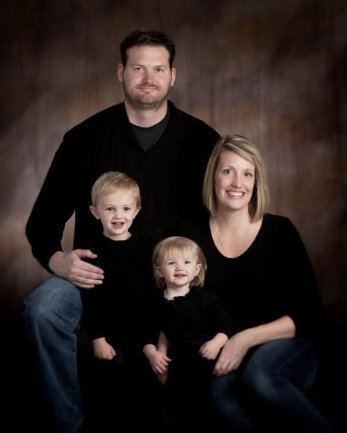
Aidan’s Animals
The story of Aidan Curry and a family’s journey towards helping and healing

Slide 2
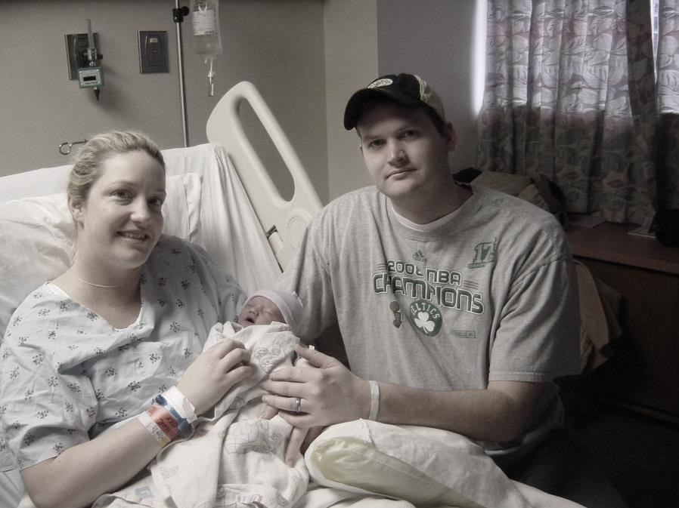
Aidan’s Story
Robert Aidan Curry was born on February 20, 2009. Although the pregnancy and delivery were rough, becoming loving parents to this amazing boy was not.

Slide 3
Aidan’s Story
We were in love…

Slide 4
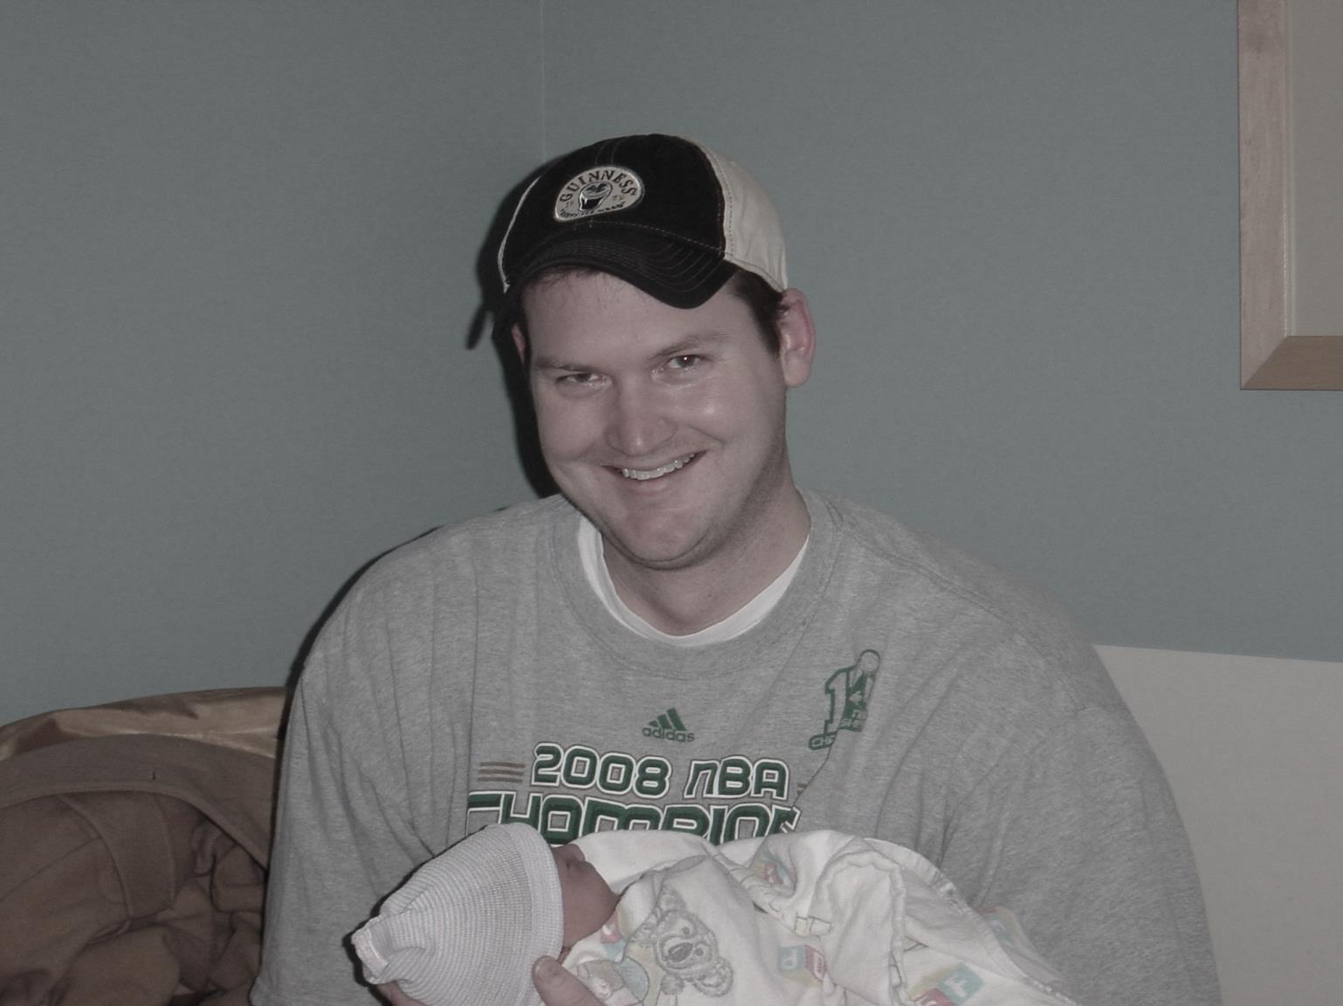

Slide 5
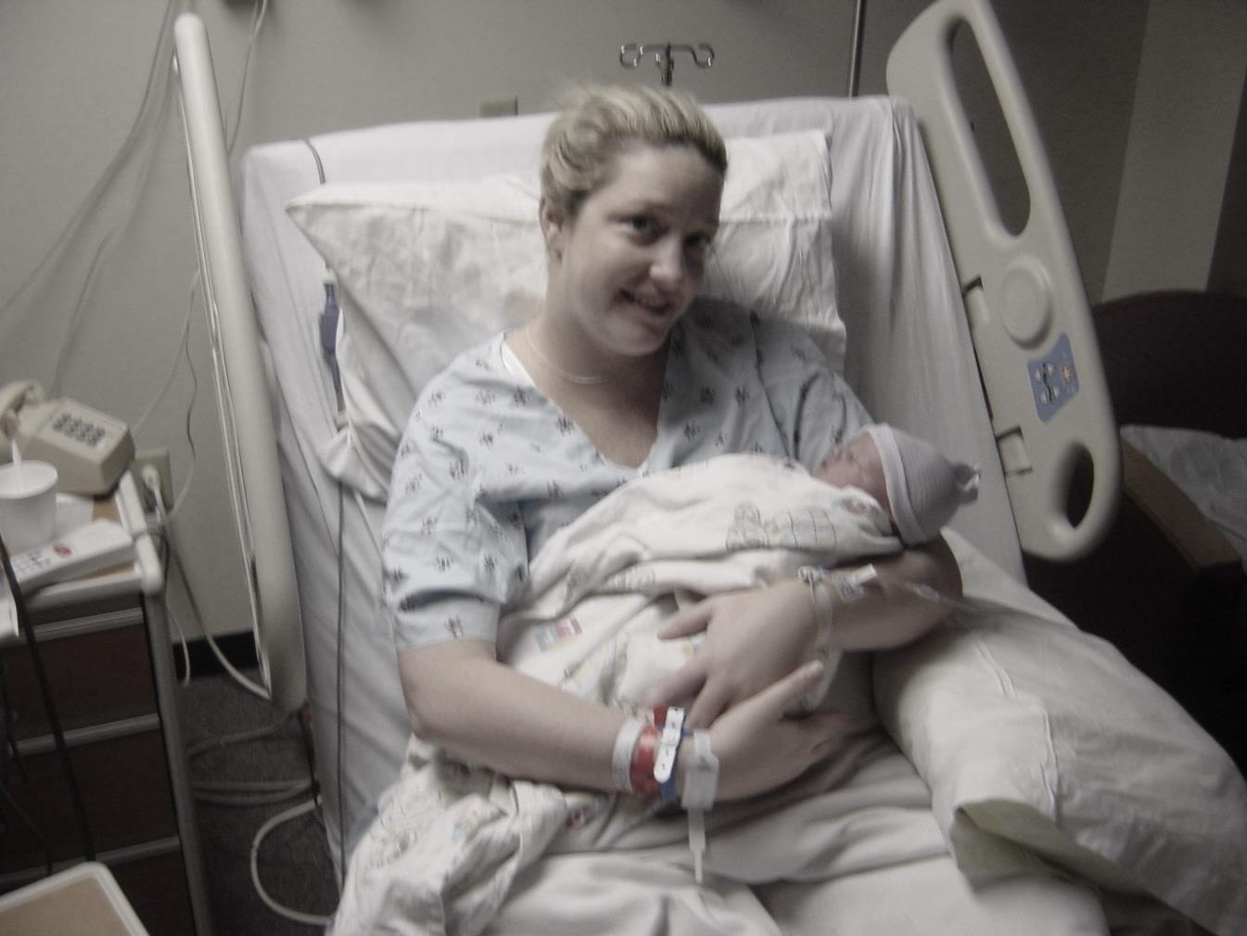

Slide 6
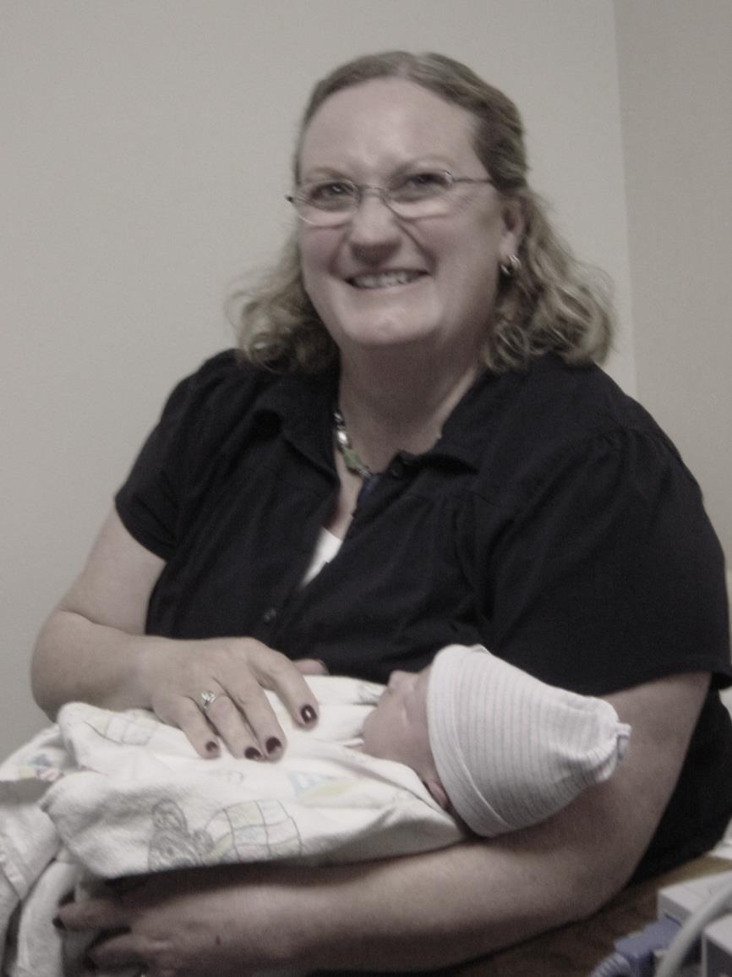

Slide 7
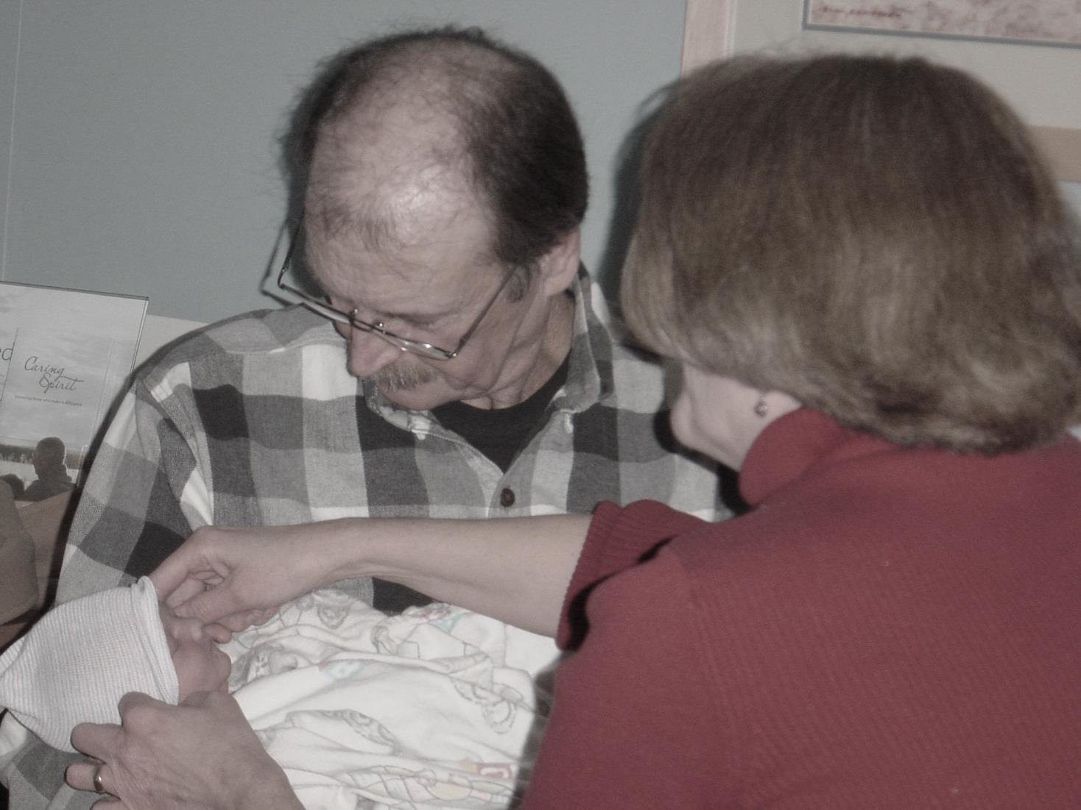

Slide 8
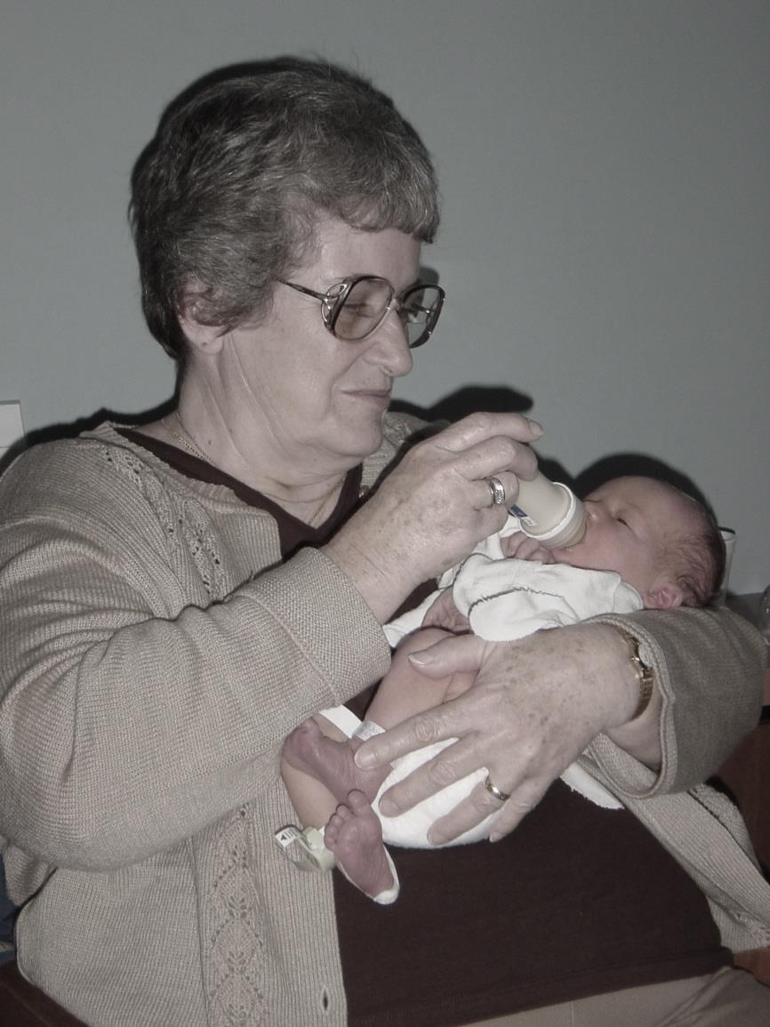

Slide 9
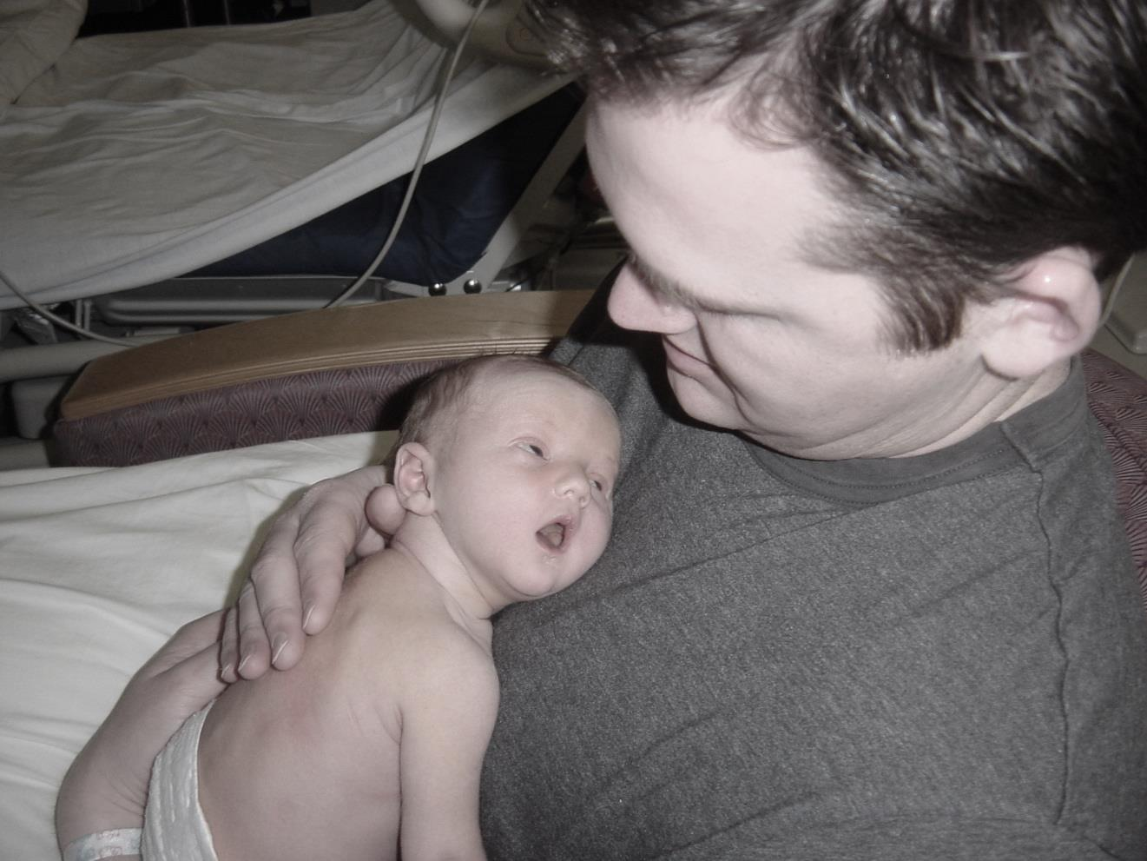

Slide 10
Aidan’s Story
Aidan was an amazing boy; with squishy baby rolls, a smile that could light up a room and an infectious laugh. He was truly the light of our lives.

Slide 11
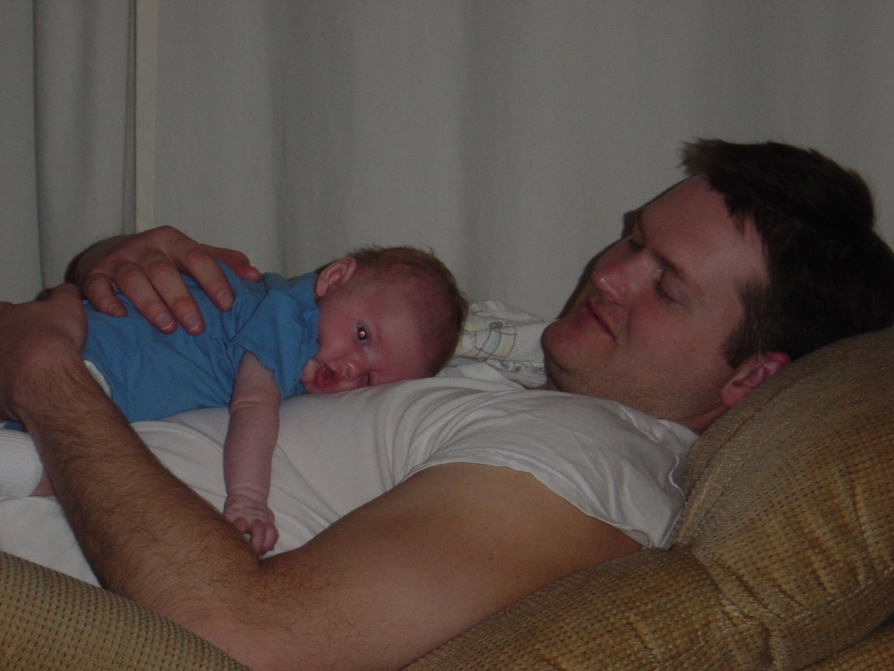

Slide 12
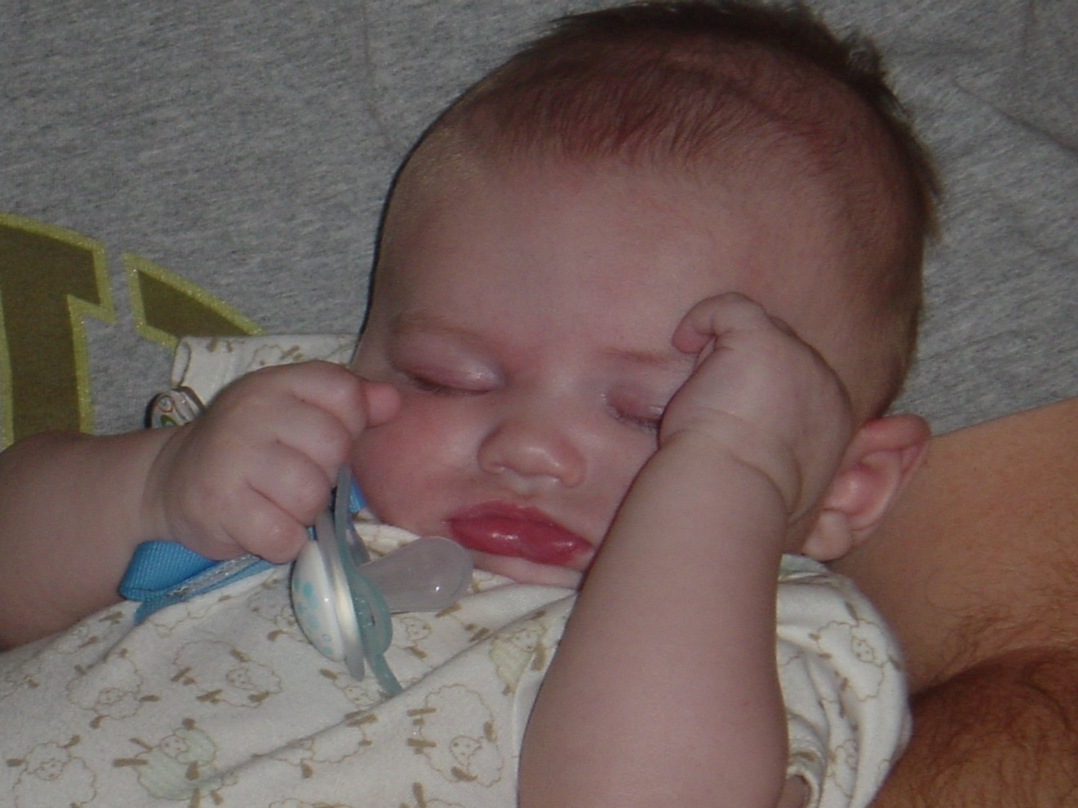

Slide 13
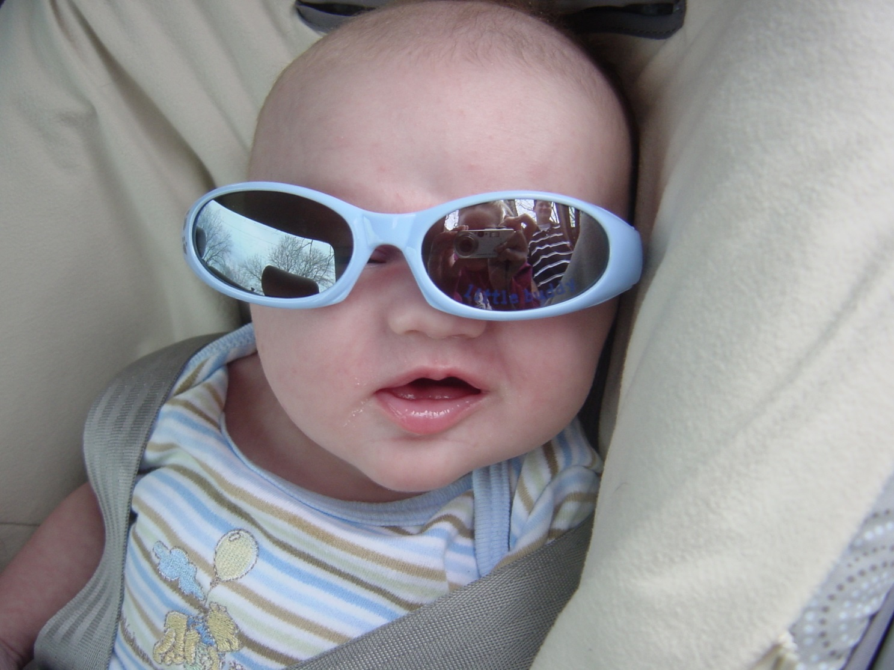

Slide 14
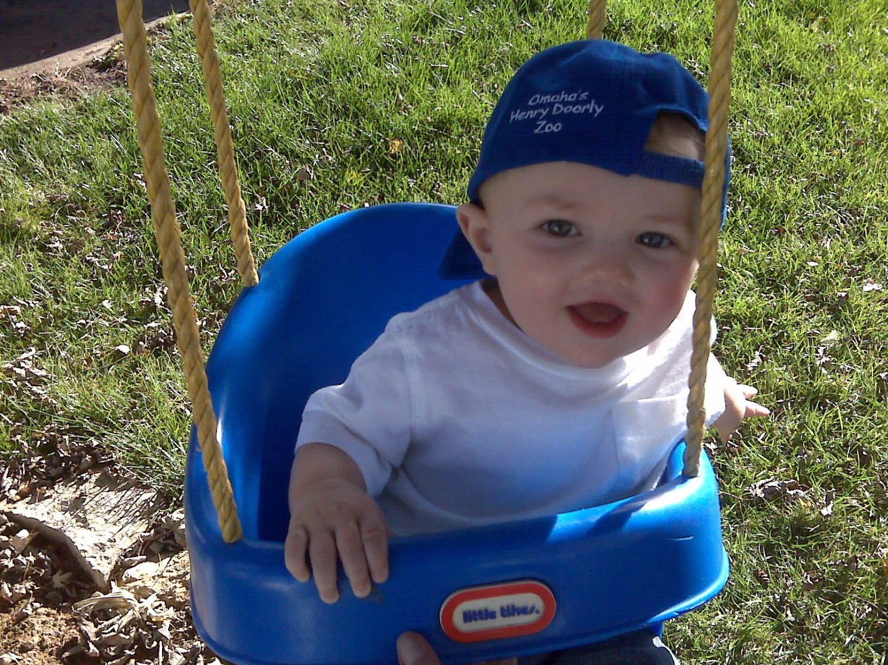

Slide 15
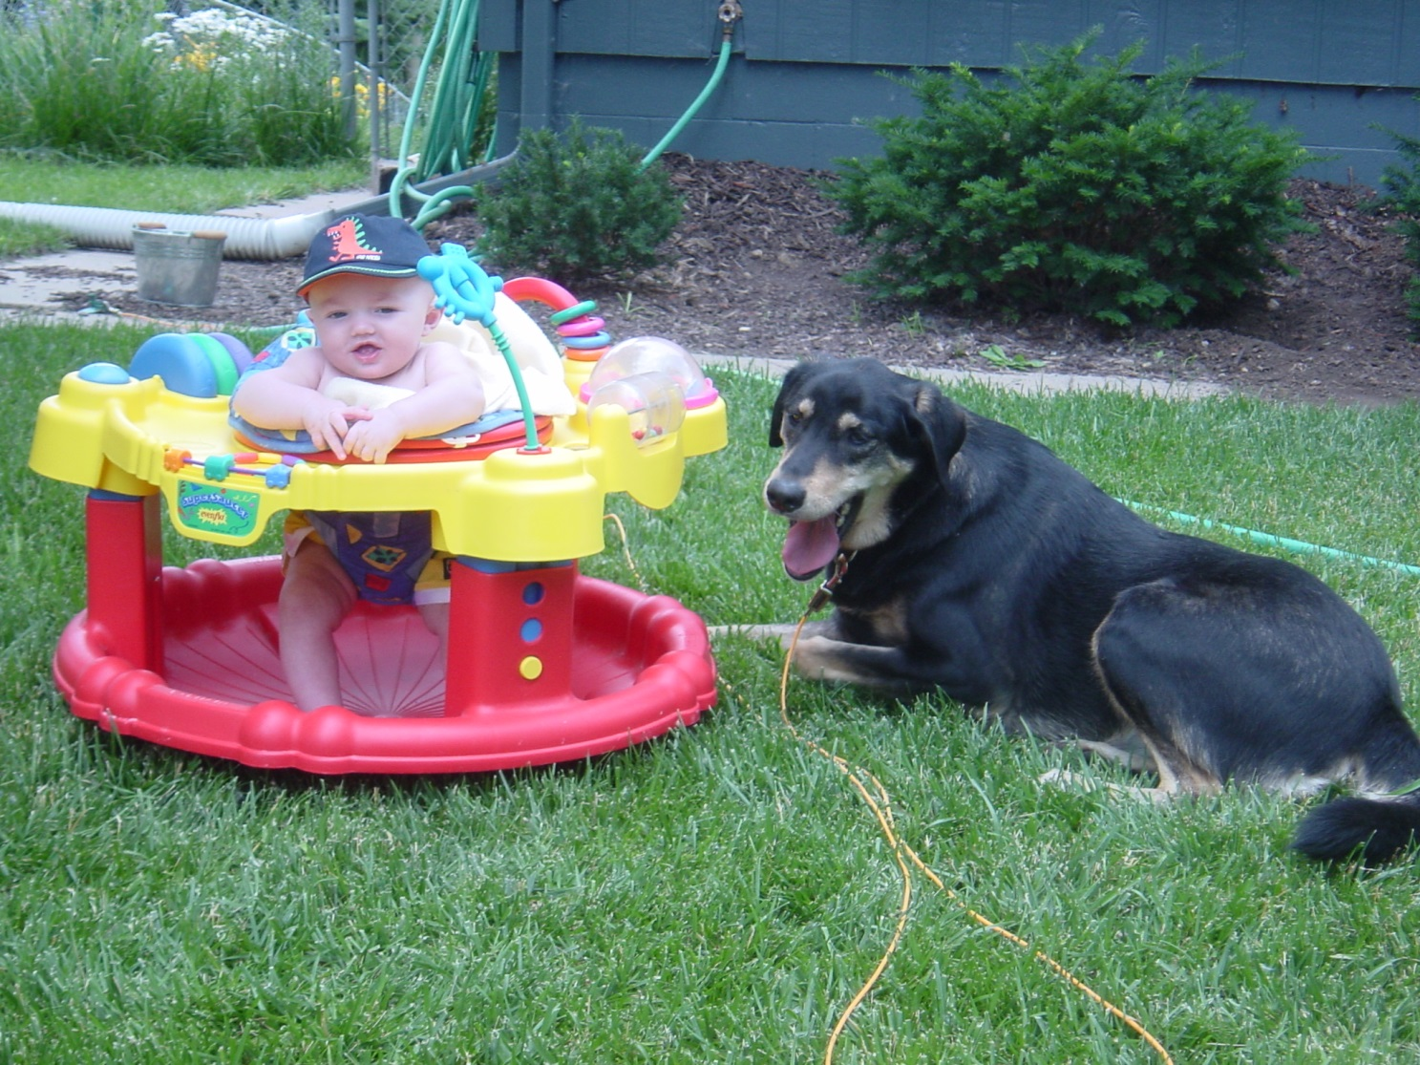

Slide 16
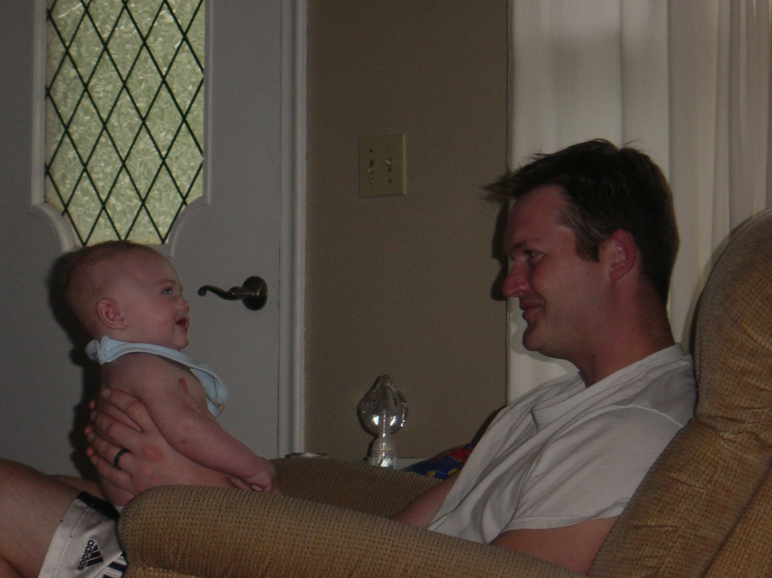

Slide 17
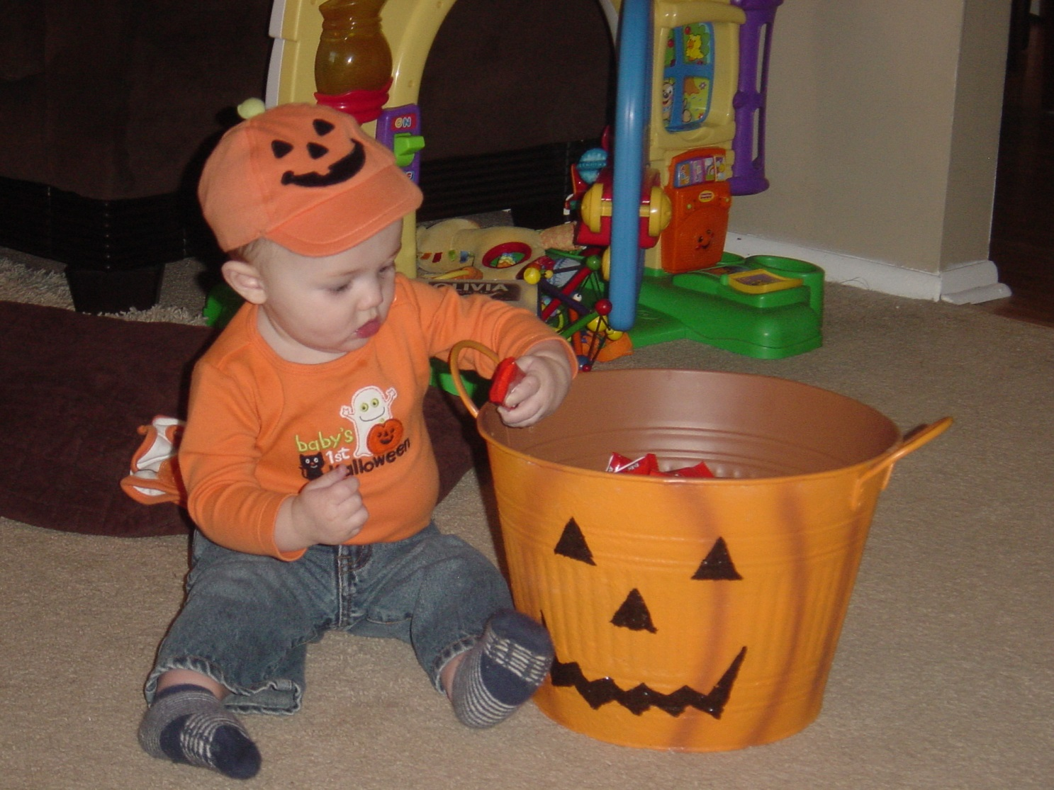

Slide 18
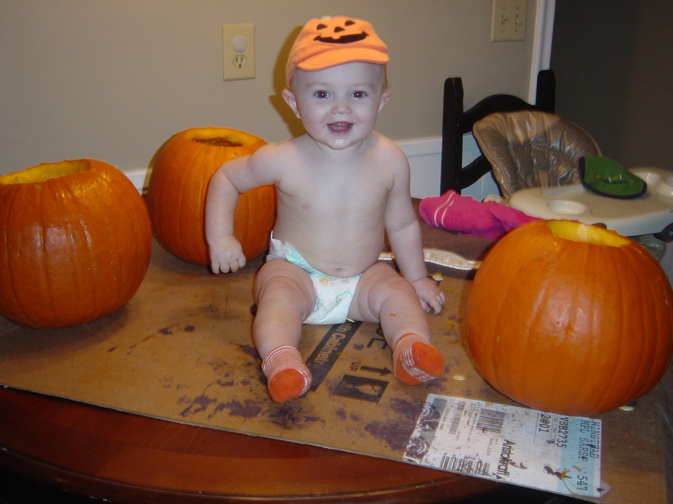

Slide 19
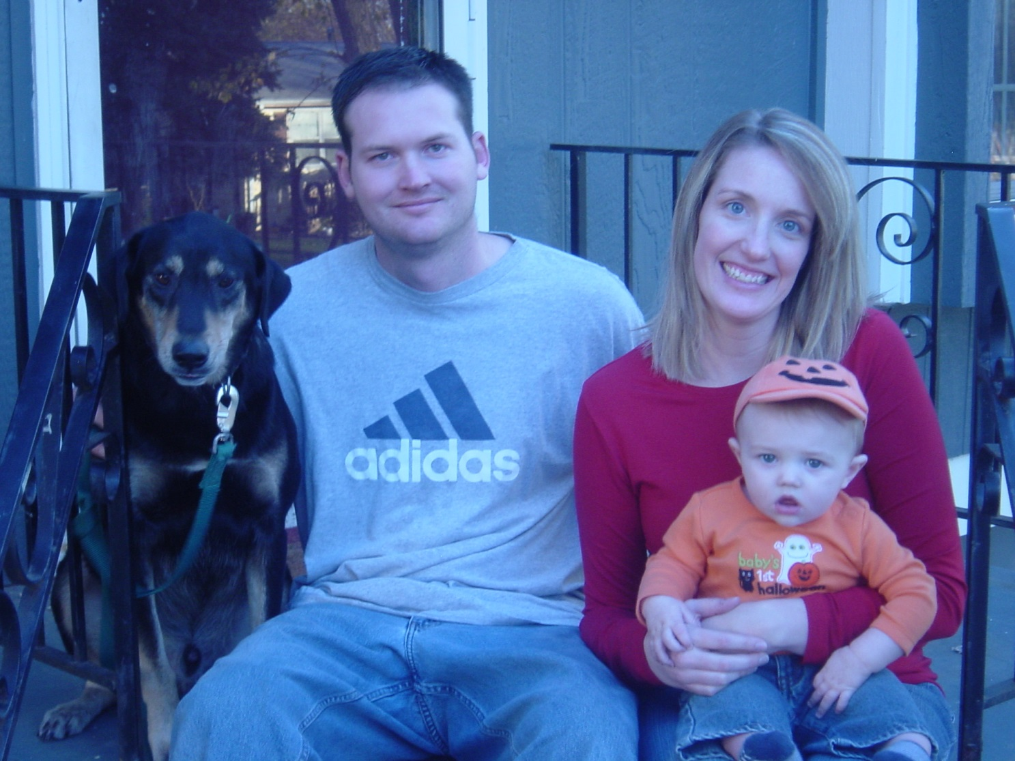

Slide 20
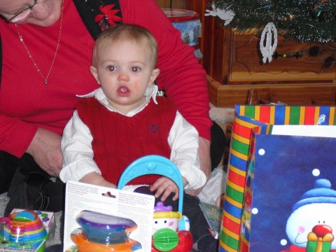

Slide 21
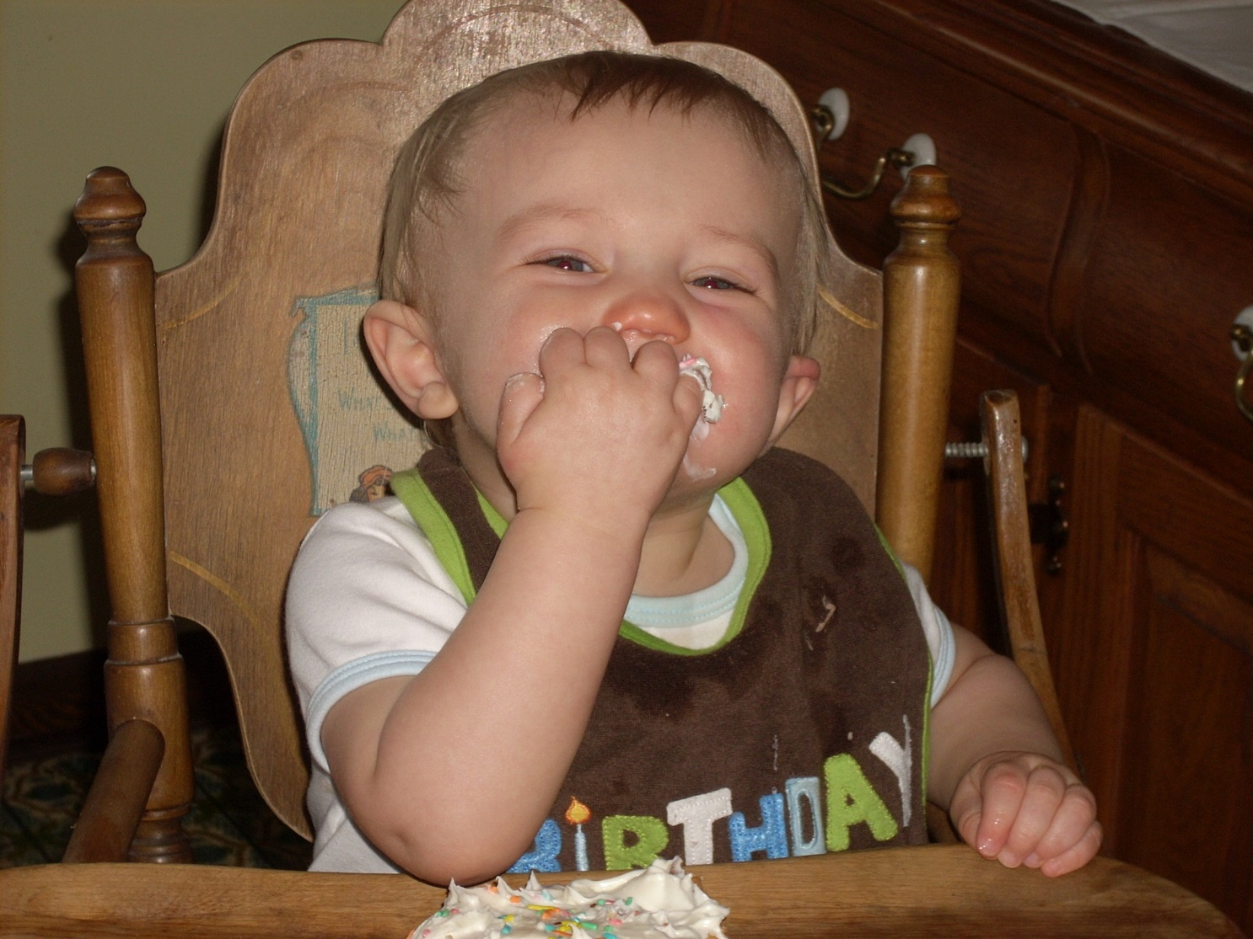

Slide 22
Aidan’s story
It was clear early on in Aidan’s life that he had a love of animals...

Slide 23
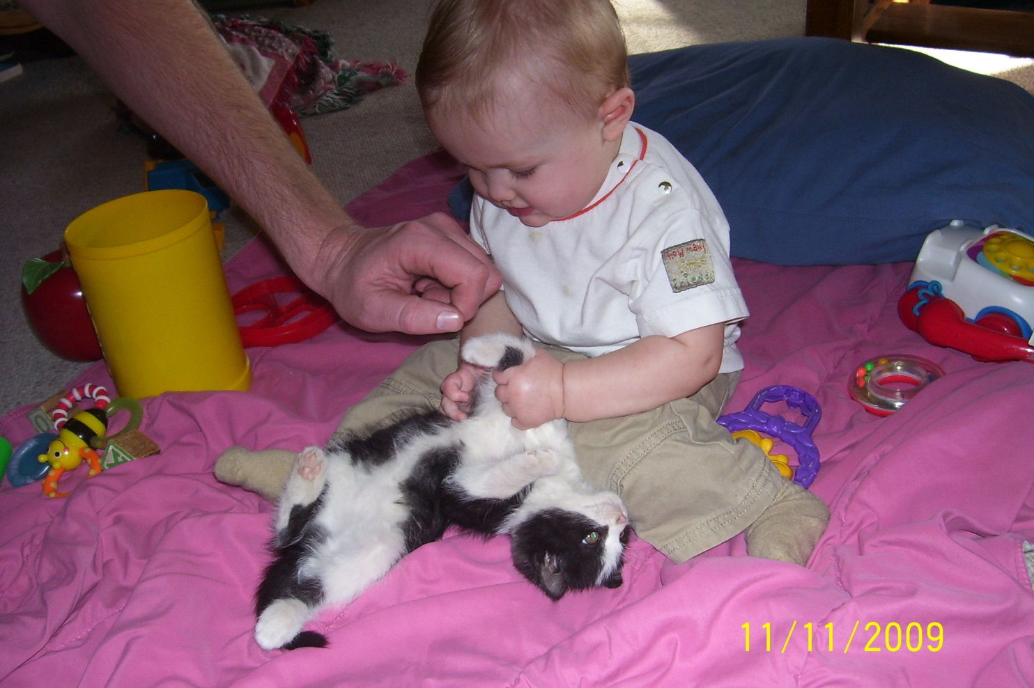

Slide 24
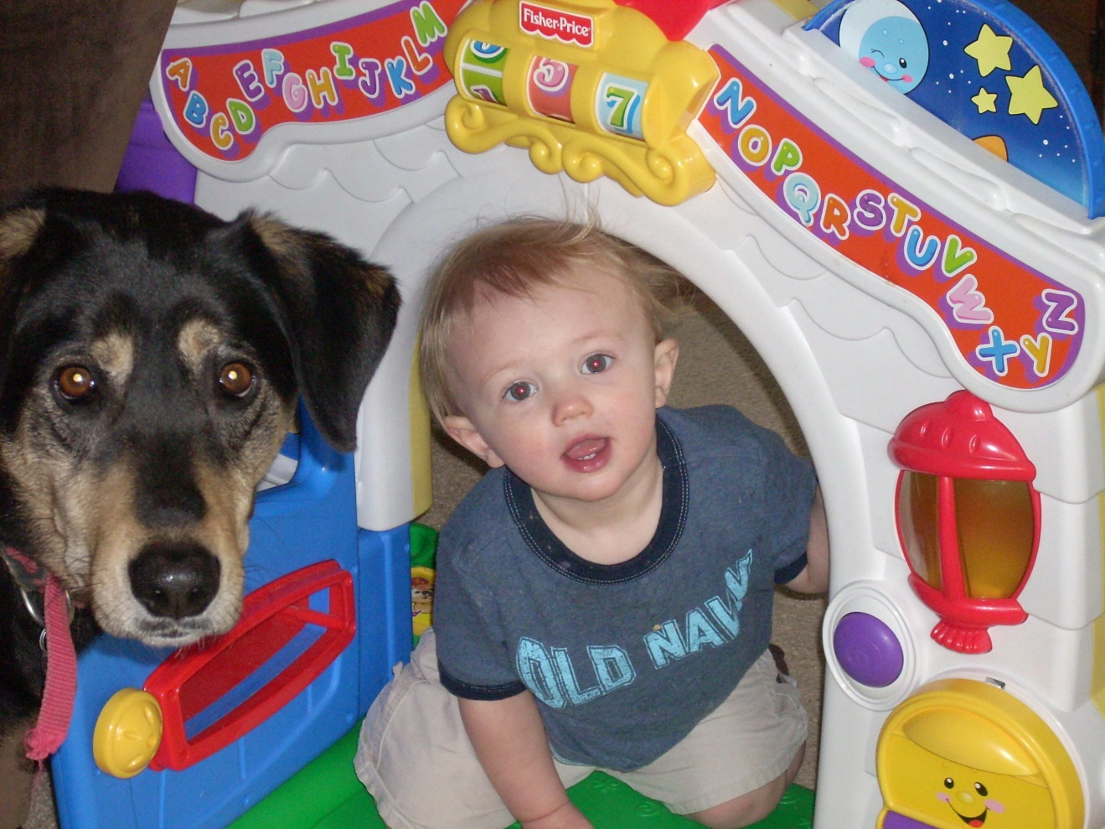

Slide 25
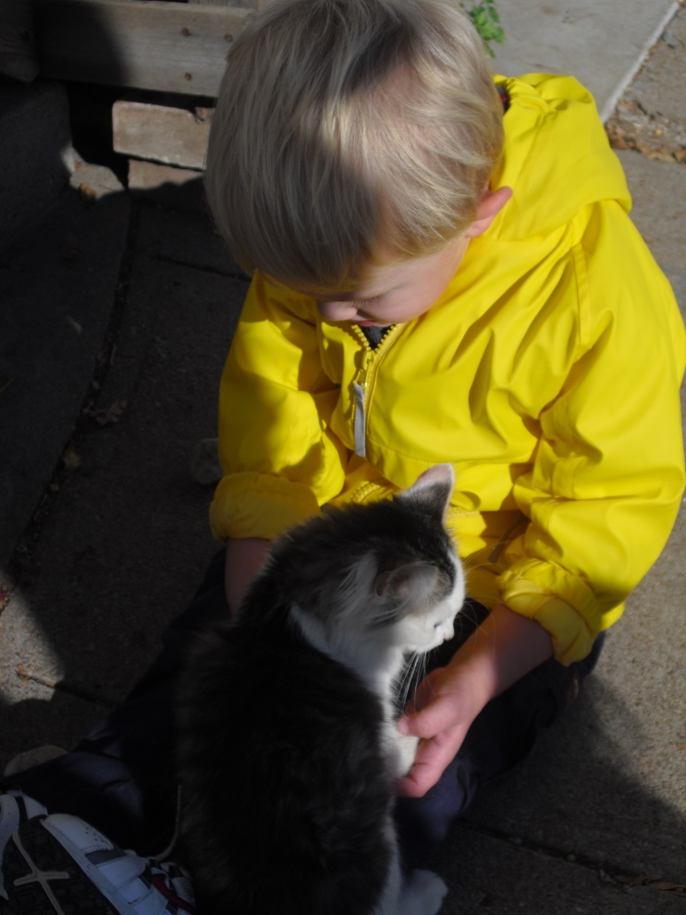

Slide 26
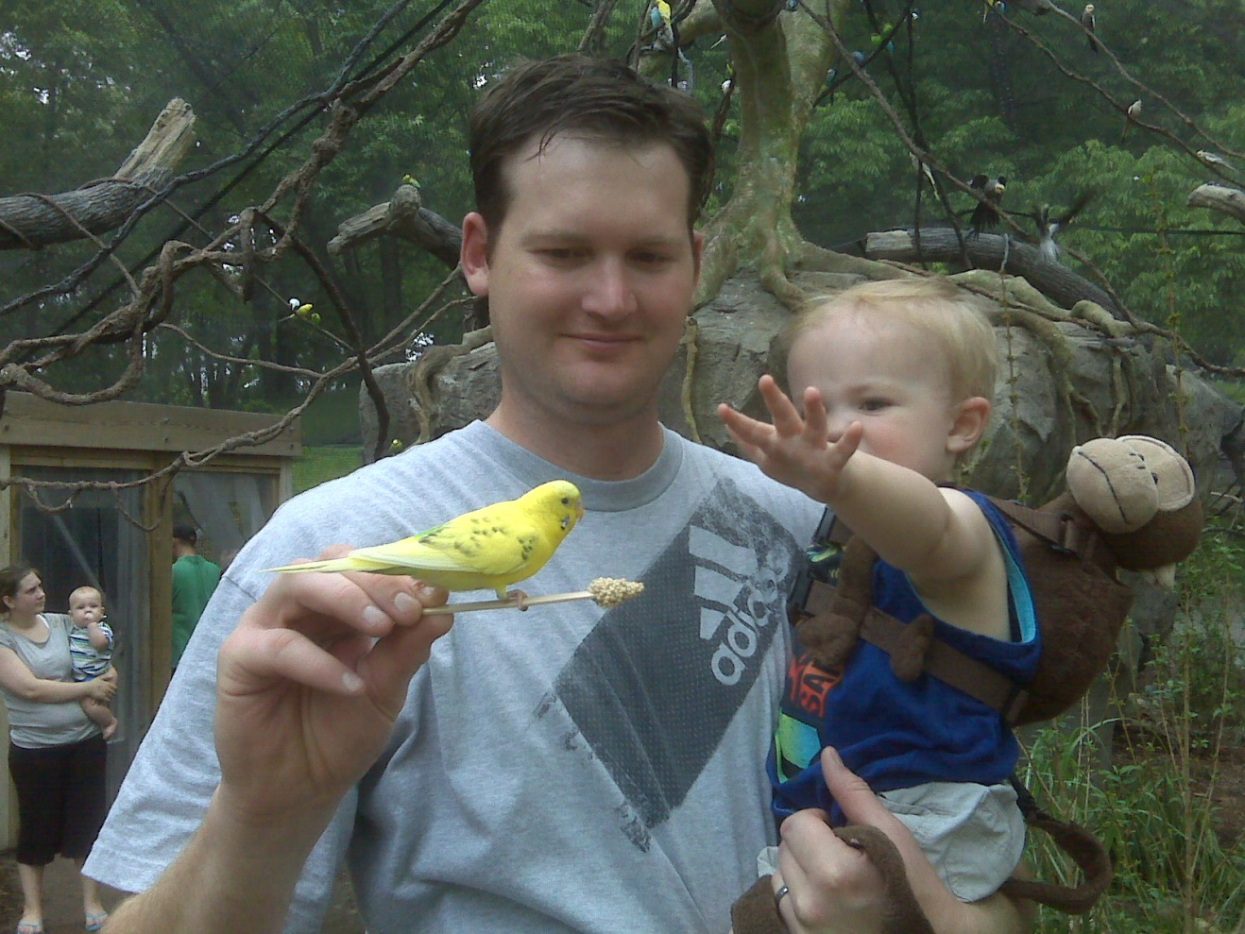

Slide 27
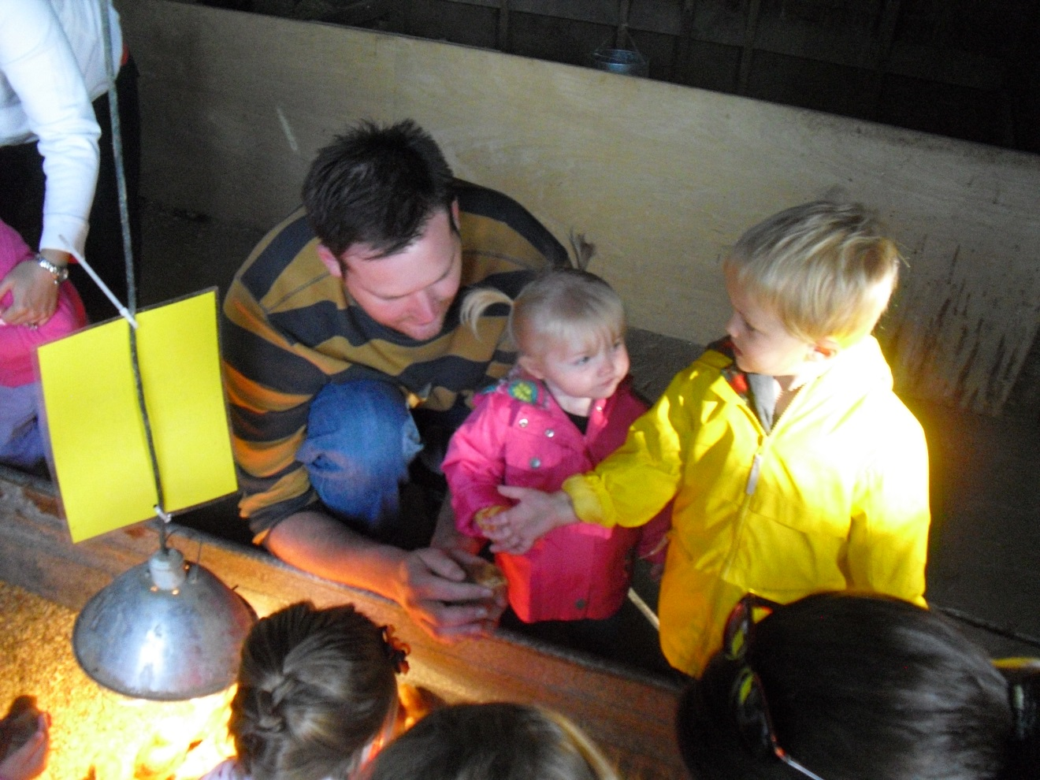

Slide 28
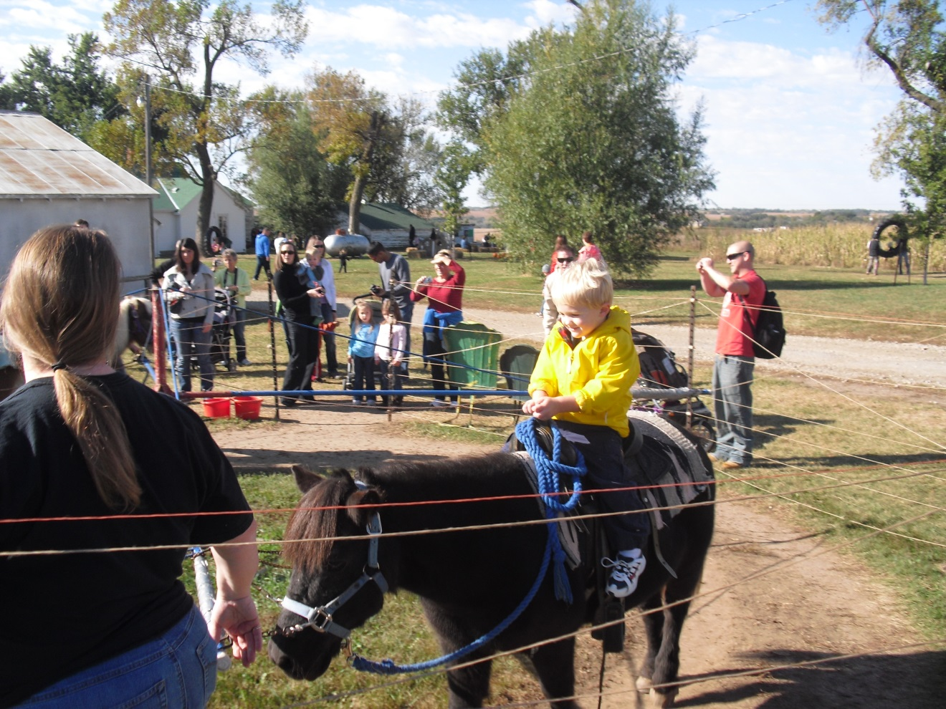

Slide 29
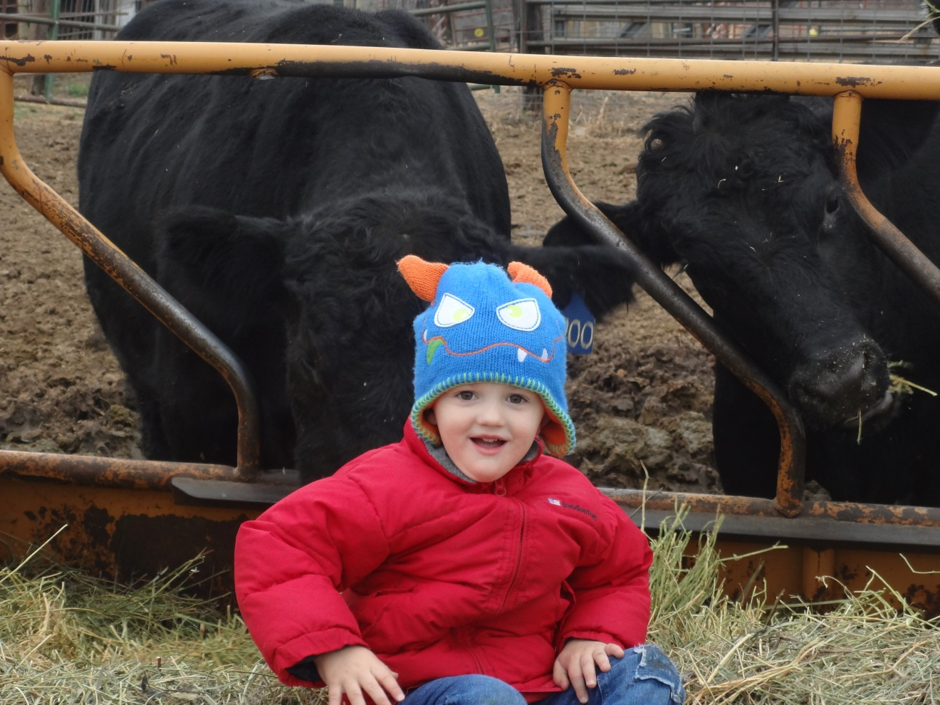

Slide 30
Aidan’s story
And a caring spirit

Slide 31
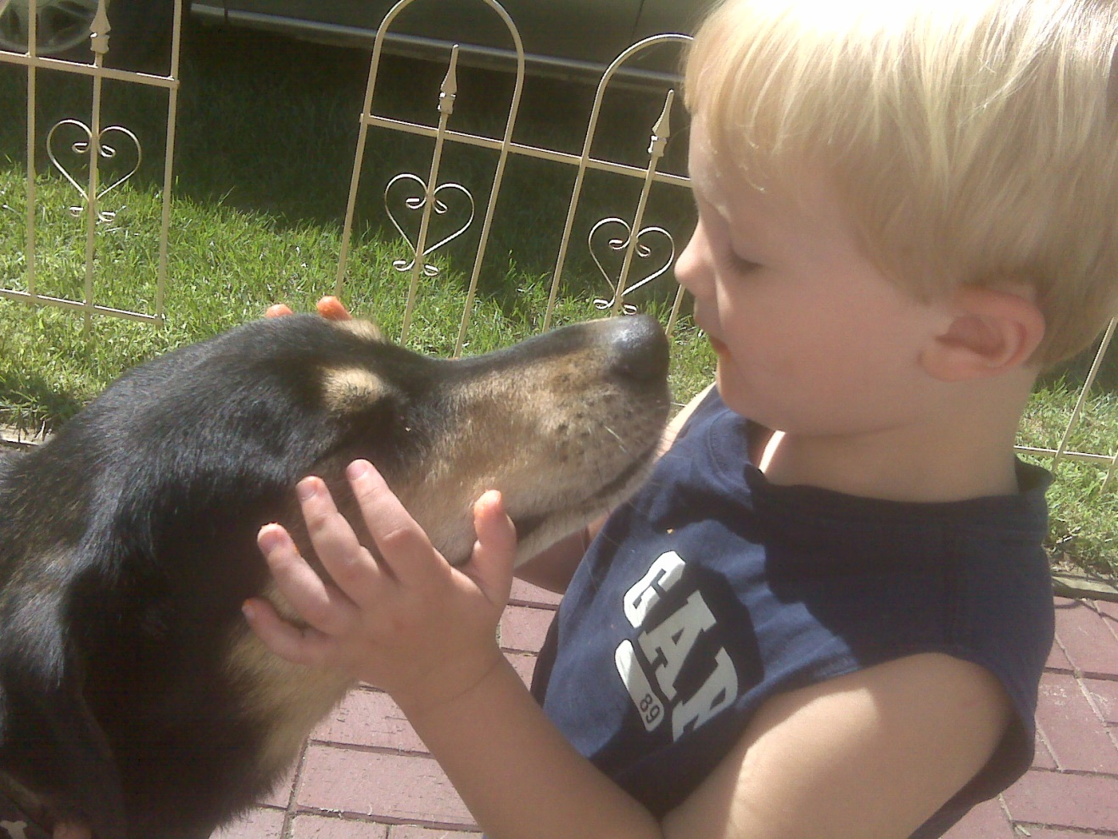

Slide 32
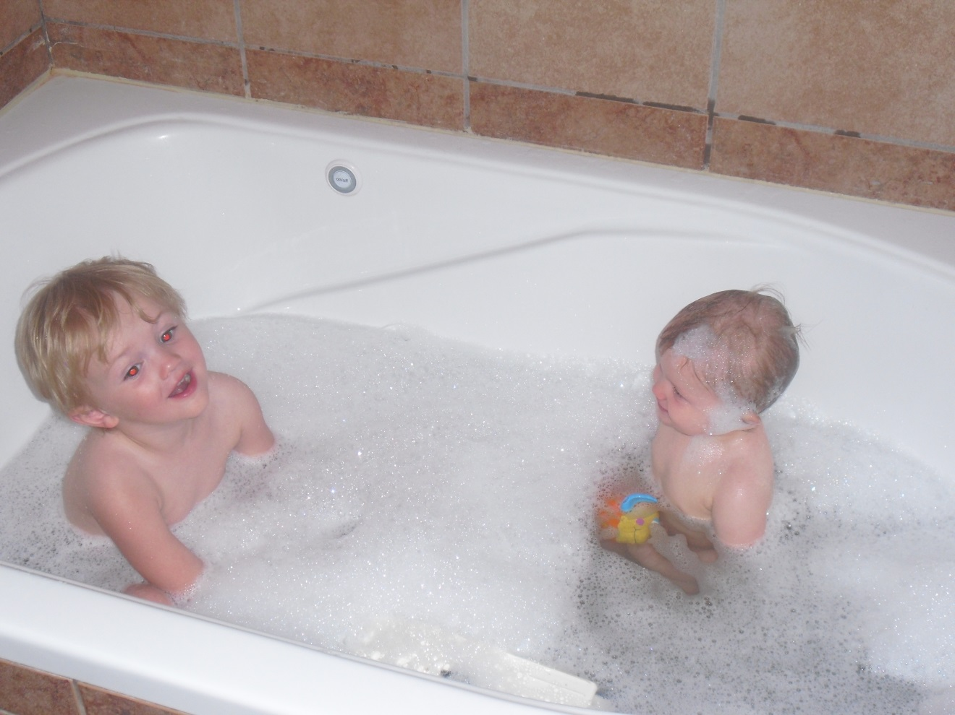

Slide 33
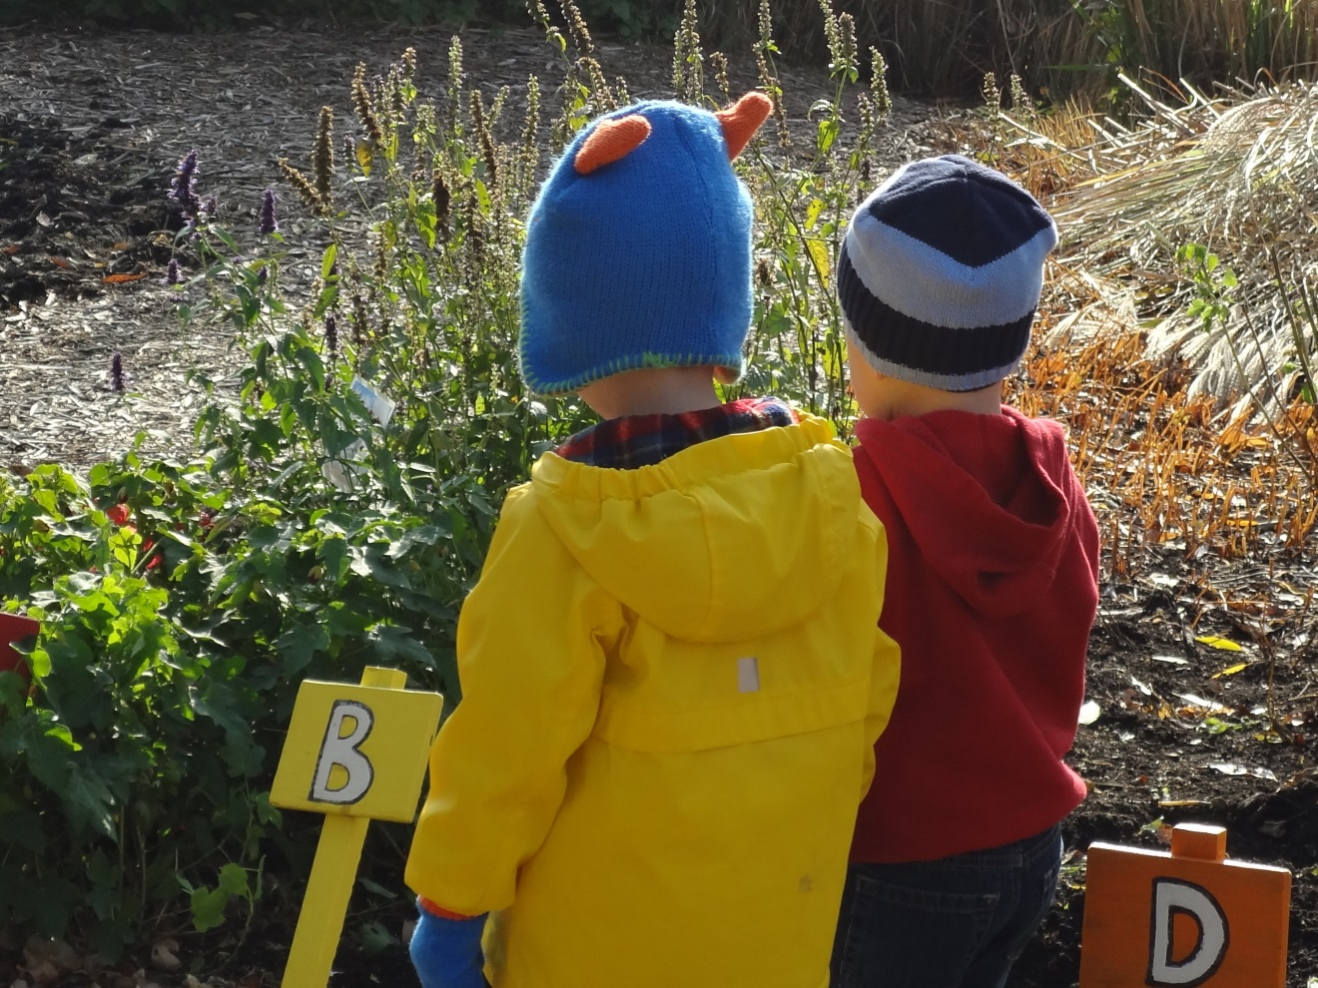

Slide 34
Aidan’s Story
In late 2011 we decided to have family photos taken. Little did I know that my choice of dates would change the course of our lives forever.

Slide 35
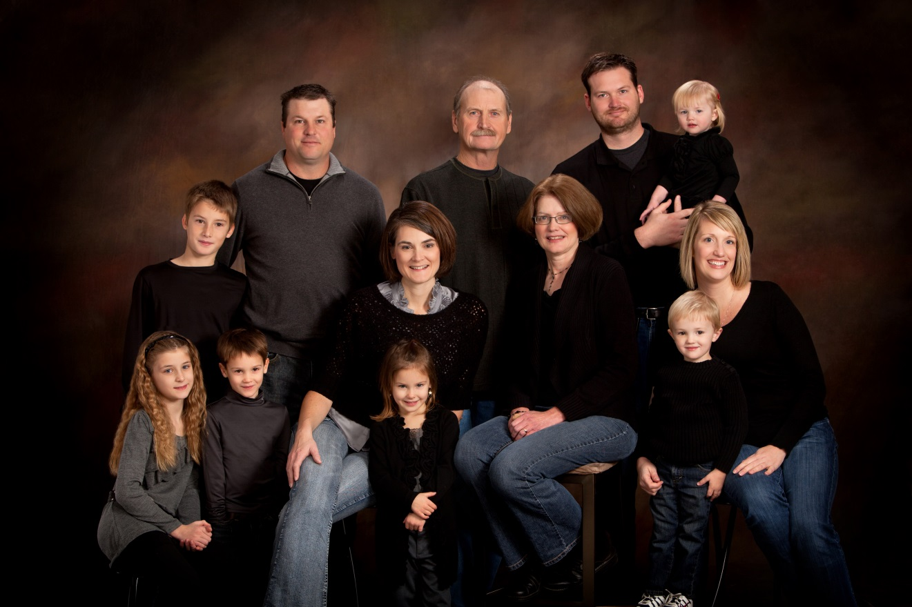

Slide 36
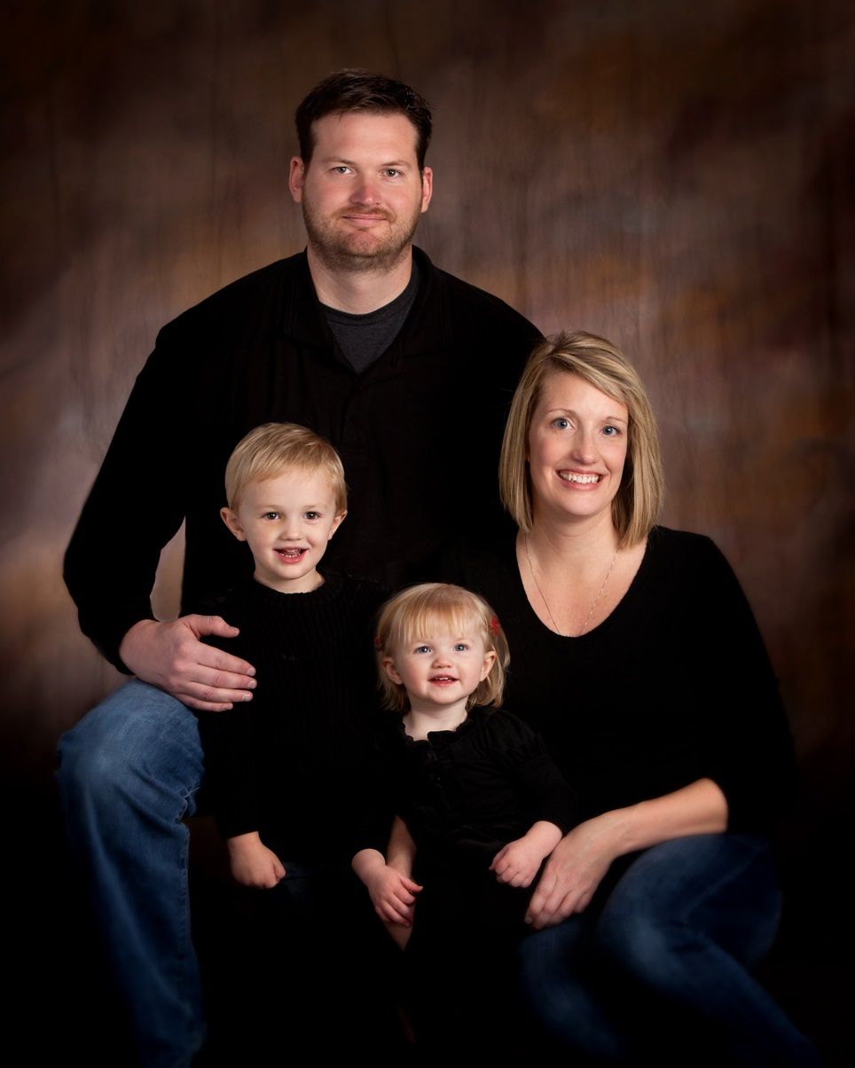

Slide 37
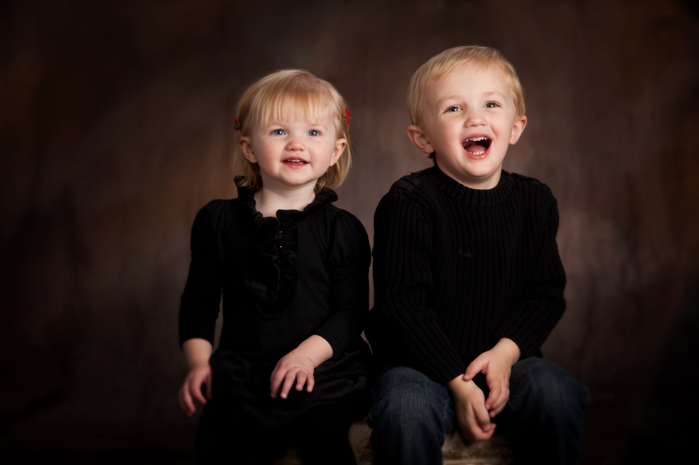

Slide 38
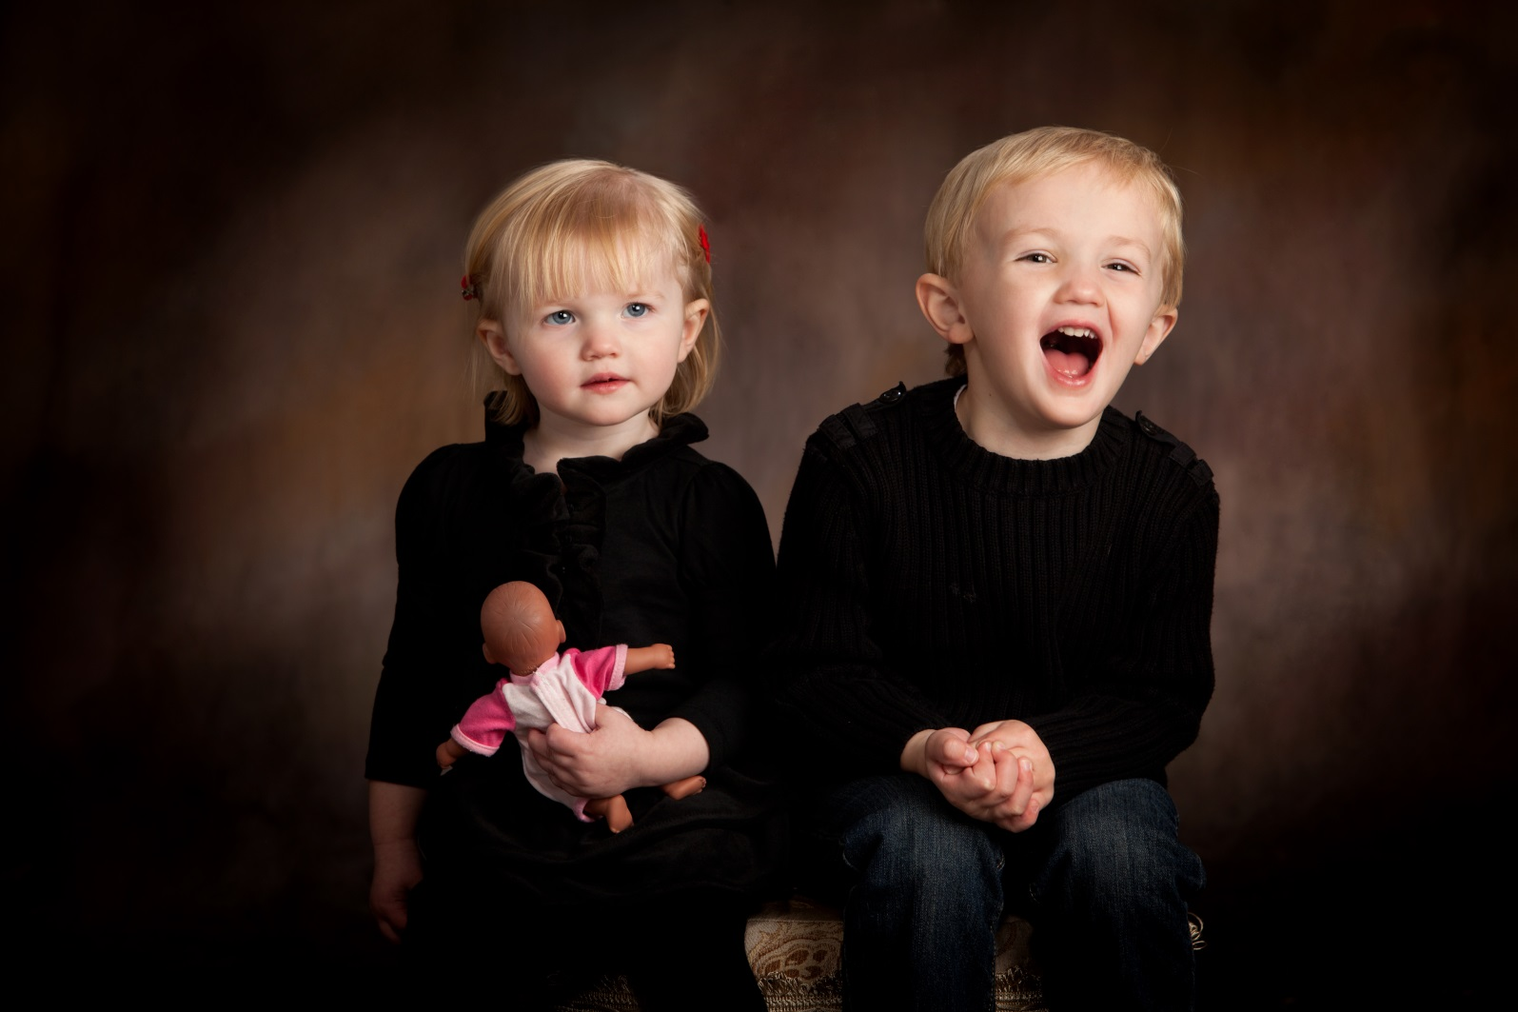

Slide 39
Aidan’s story
In true Aidan style, 4 days before pictures he ran into the corner of a picnic table at day care & cut his eye. While I cringed at the time & hoped the wonderful photographers at Shane & Sunny could edit his latest scrape out, I failed to realize that soon those un edited photos would become some of my most cherished pictures.

Slide 40
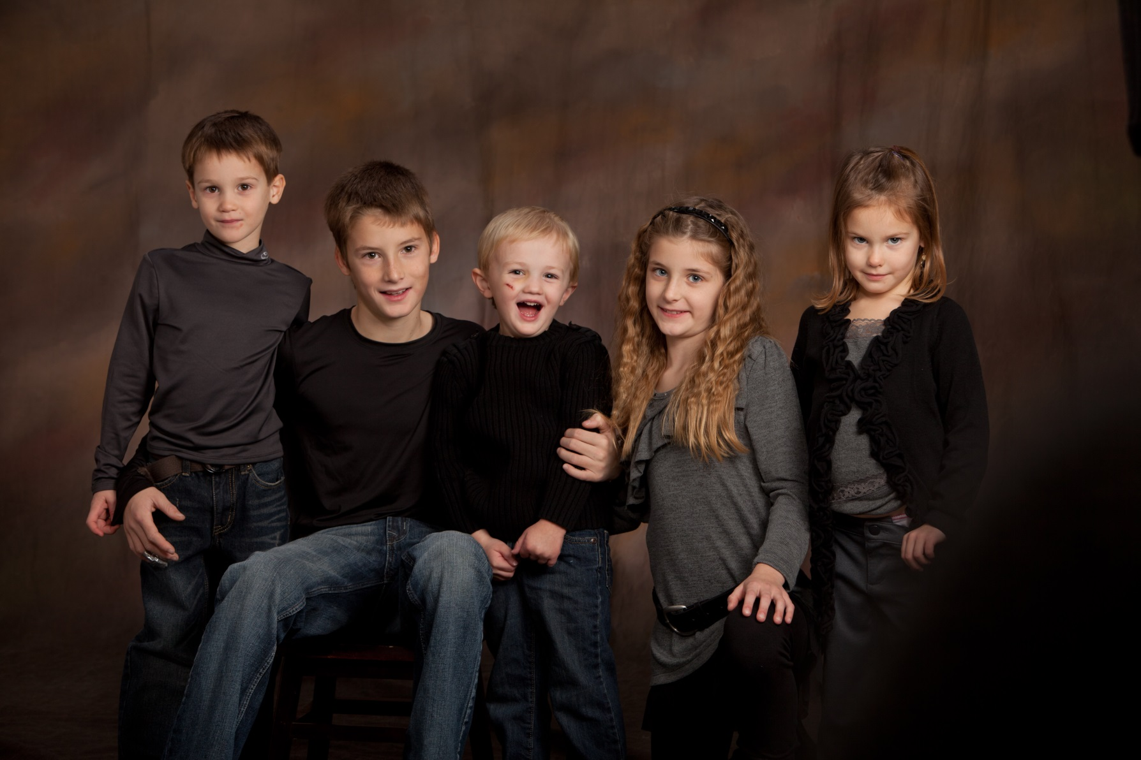

Slide 41
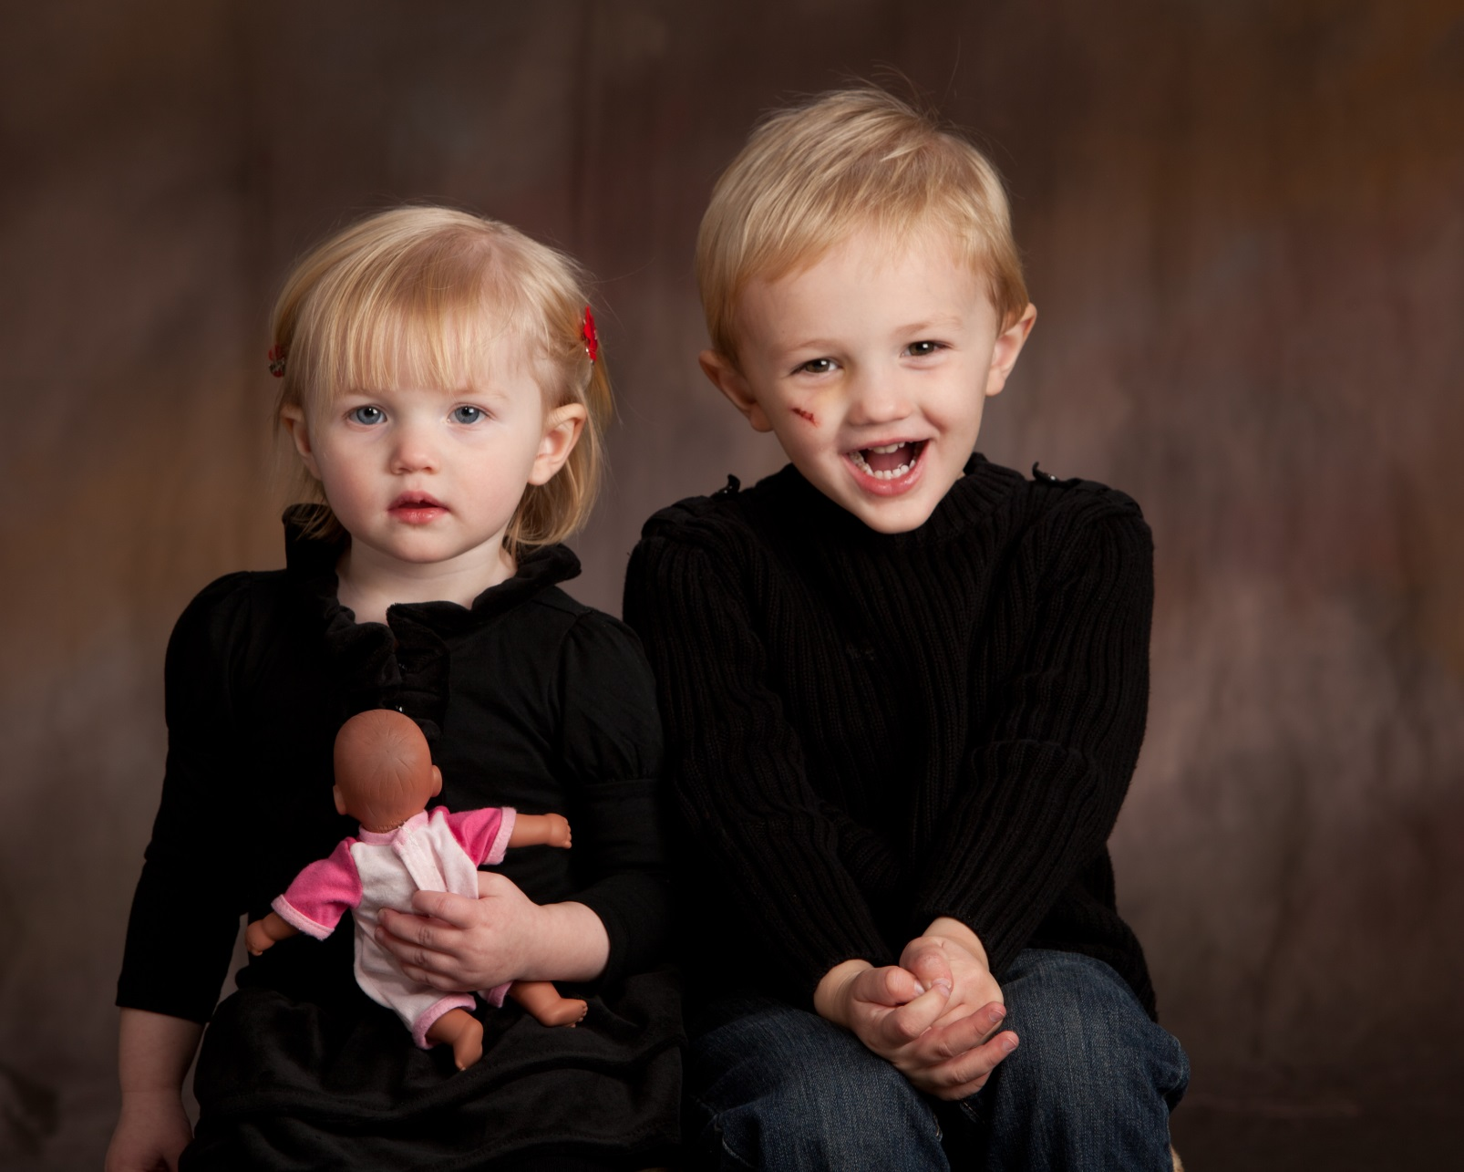

Slide 42
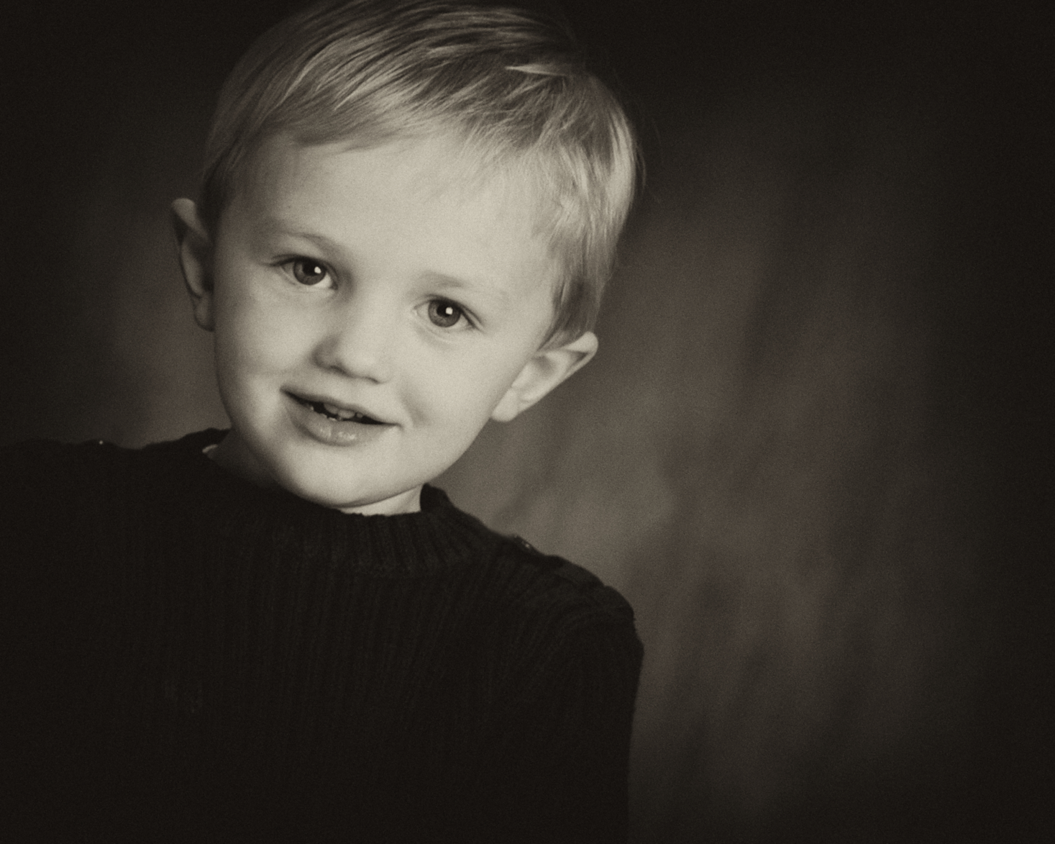

Slide 43
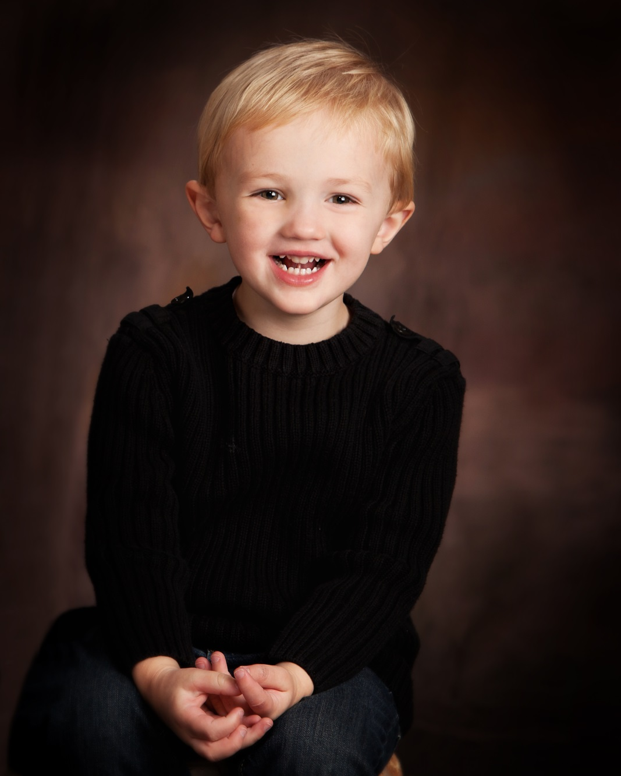
December 3, 2011
11 AM

Slide 44
Aidan’s story
By 4:30 PM that same cold December Saturday, the pictures I held in my head of that day would be forever altered.

Slide 45
Aidan’s story
While driving home to Bellevue from Lincoln, our family car was rear ended by a speeding tractor trailer. Our car spun into the ditch and came to an abrupt stop. The silence in our car was deafening.

Slide 46
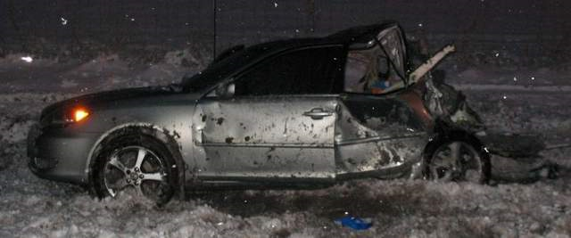
December 3, 2011
6 PM

Slide 47
Aidan’s story
When I turned to check on our children secured in their safety seats in the back seat, I found my son unconscious and bleeding.

Slide 48
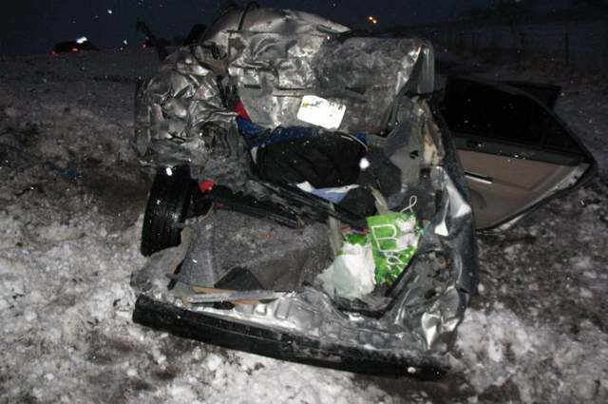
December 3, 2011
6 PM

Slide 49
Aidan’s story
Our daughter Ansley was, miraculously, unharmed still fastened in her seat. I pulled her out as fast as I could and tried desperately to free Aidan so I could start CPR, but it was too late.

Slide 50
Aidan’s story
I never dreamed in those first few days of Aidan’s life that I would ever have to write his obituary. But there I was, 3 weeks before Christmas and 2 ½ months before his 3rd birthday, writing it.

Slide 51
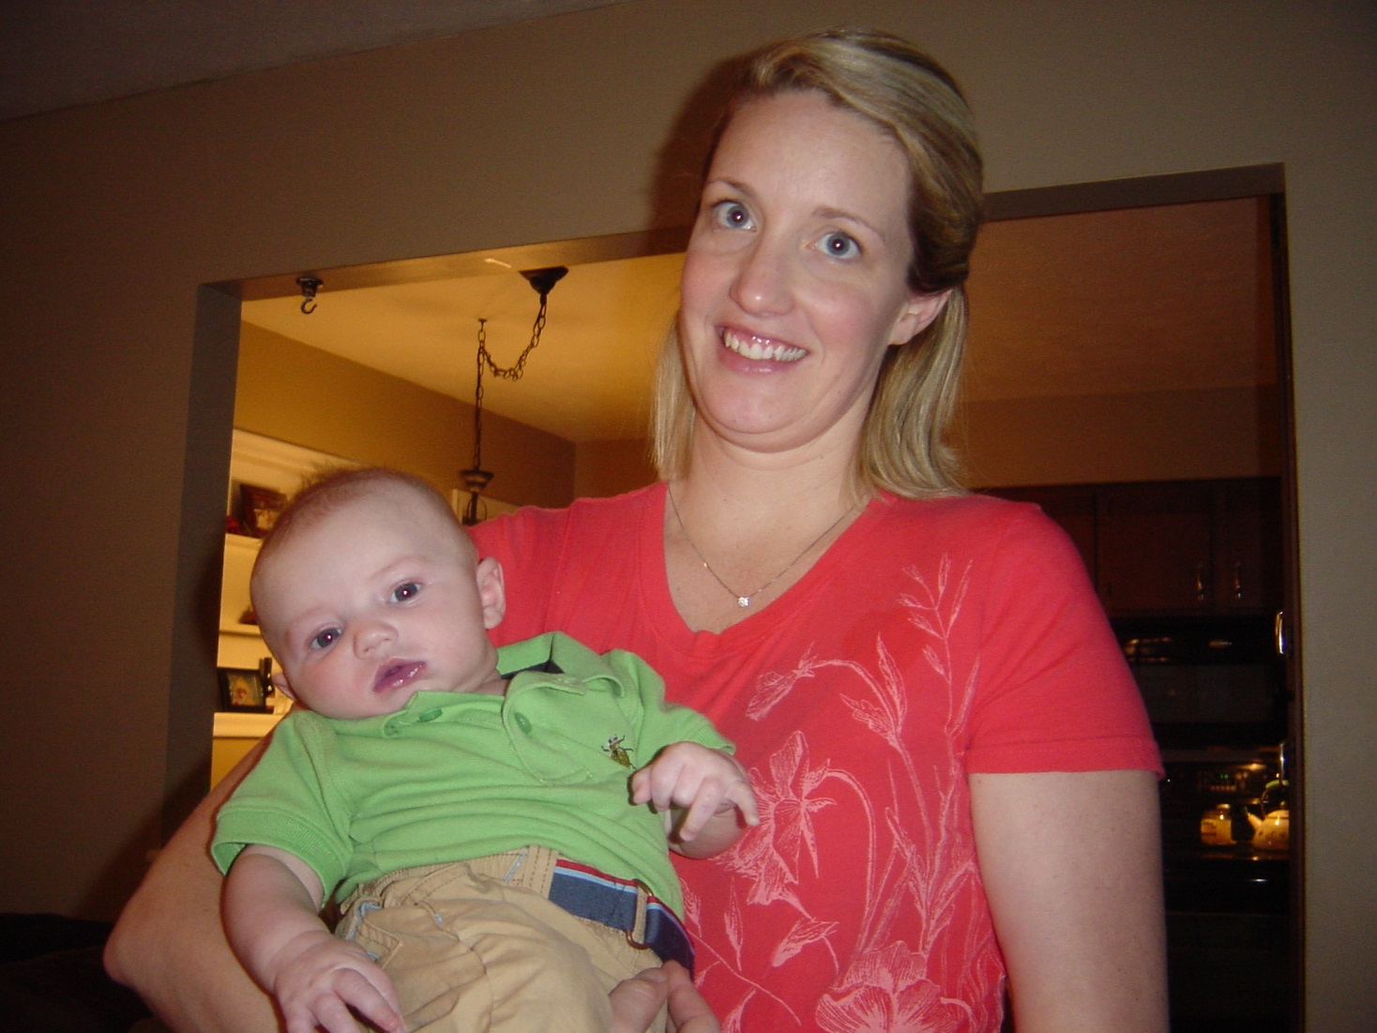

Slide 52
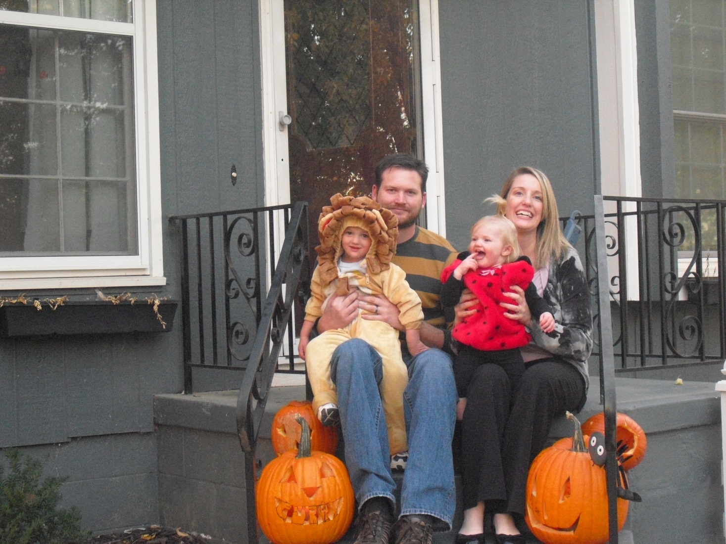

Slide 53
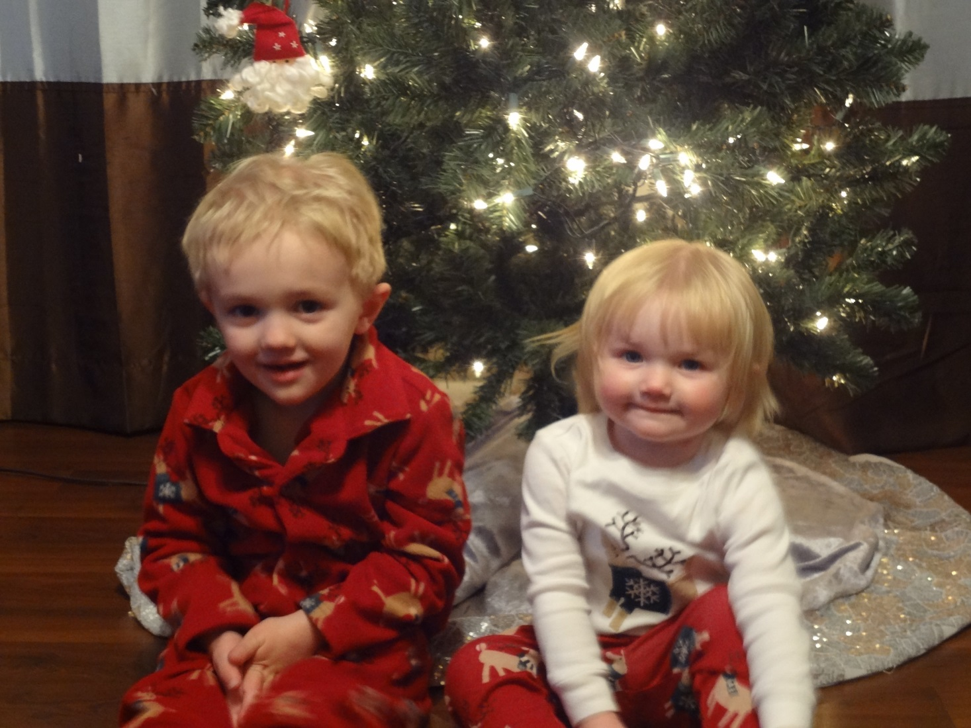

Slide 54
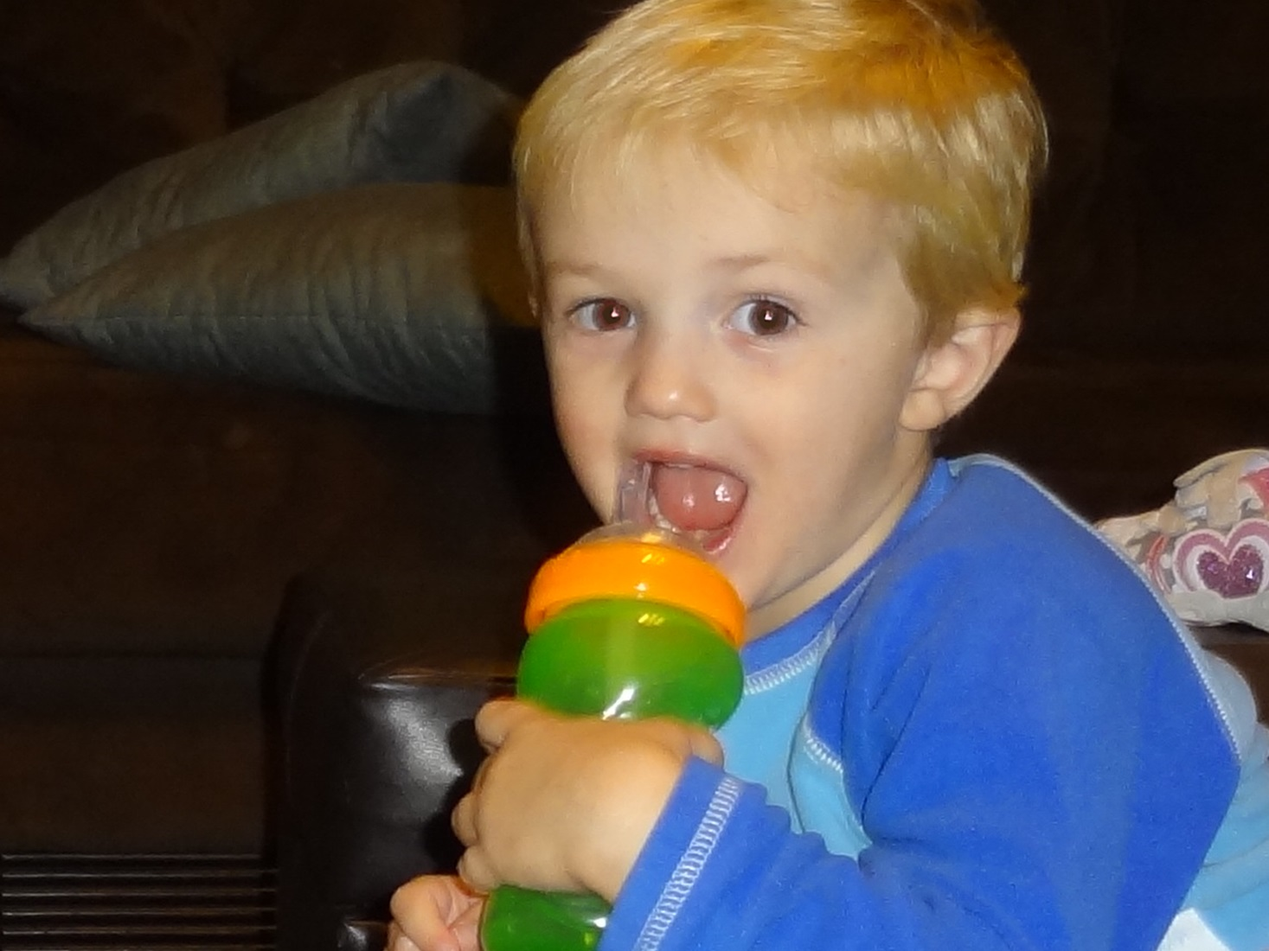

Slide 55
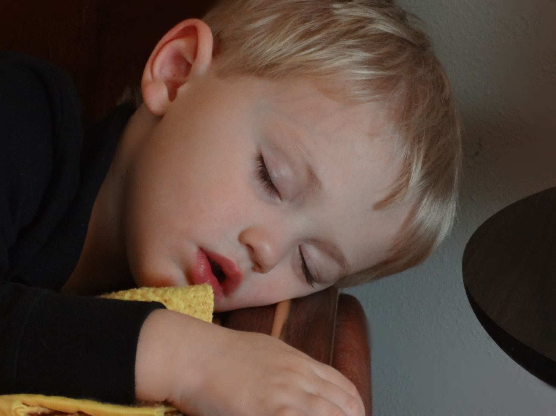

Slide 56
The birth of Aidan’s Animals
Despite our devastation and the incredible loss, we were acutely aware of one thing; our daughter was alive and well.

Slide 57
The birth of Aidan’s Animals
While we know that none of our actions could have saved Aidan that fateful day, we know that some of our actions saved our daughter.

Slide 58
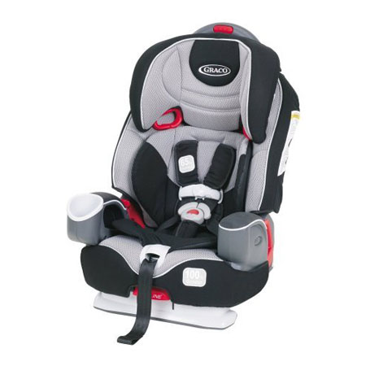

Slide 59
The birth of Aidan’s Animals
Our use of an up to date, safety rated and correctly installed child safety seat was not enough to save our son, but it was the ONLY thing that saved our daughter that day.

Slide 60
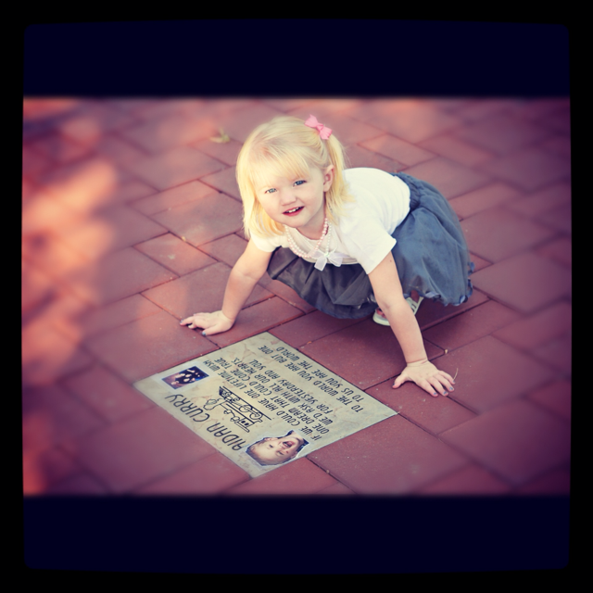

Slide 61
The birth of Aidan’s Animals
As days, then weeks and months passed, we felt as though even though we had suffered an immeasurable loss, we had been the recipients of much kindness from the community.

Slide 62
The birth of Aidan’s Animals
It was this kindness and Aidan’s love for animals that inspired the 501©3
“Aidan’s Animals”

Slide 63
The birth of Aidan’s Animals
So we slowly began collecting new blankets and stuffed animals and giving them to first responders like the state patrol, ERs and EMTs who had been so kind to us. They in turn passed these items out to children who suffered traumas such as the one our family faced that December day.

Slide 64
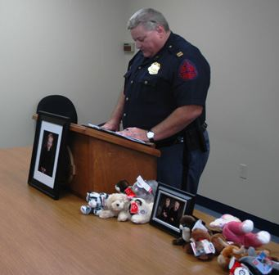

Slide 65
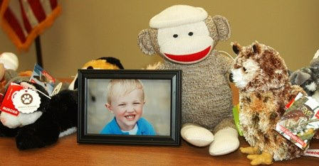

Slide 66
The birth of Aidan’s Animals
As we began to find more success, we wanted to do more for the community. We decided that helping others ensure their child’s safety in the car was the next natural step, so we started the Aidan’s Animals initiative “Karseats for Kids”.

Slide 67
The birth of Aidan’s Animals
After several fundraising efforts and generous support from the community, we sought out the opportunity to partner with “Safe Kids Lincoln/Lancaster County”

Slide 68
The birth of Aidan’s Animals
On August 10th, 2013 we sponsored our first child safety seat check, installation and give away event.

Slide 69
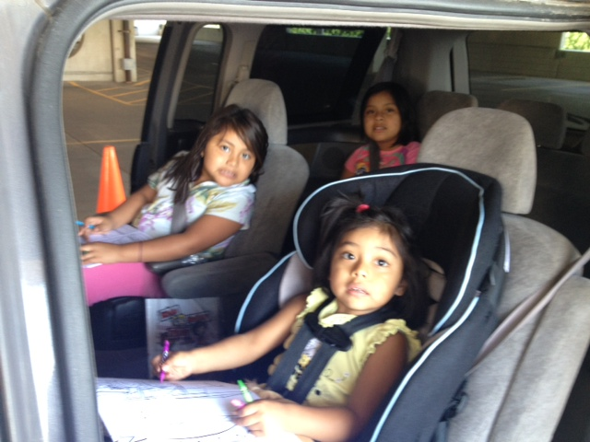

Slide 70
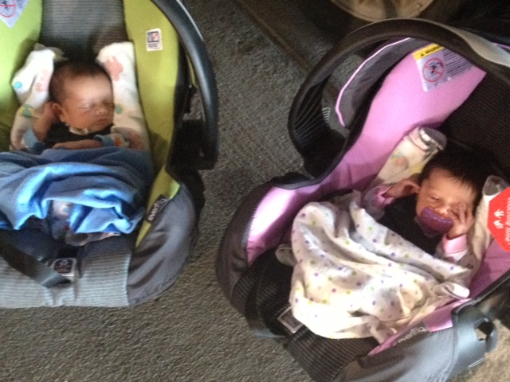

Slide 74
The birth of Aidan’s Animals
We can’t thank Safe Kids Lincoln-Lancaster County enough for all they do to help protect our kids each and every day. Aidan’s Animals is enormously proud and honored to be a part of your great work. Thank you!

